Slide 1

ABB Customer World 2019
March 4-7 | Houston, Texas
What
An innovative look at new ideas, trends and technologies transforming the future of:
Energy
Manufacturing and machines
Smart buildings
Mobility
Work
View ABB Customer World 2017 wrap-up video for a closer look
Why
Hundreds of workshops allow you to customize a learning experience tailored to your needs
Hands-on training and demos for ABB products
Earn up to 14 Professional Development Hours
Develop your network, connect with experts and peers in your industry
See the latest product innovations from the markets widest power and automation provider, including our expanded portfolio with B&R and GE Industrial Solutions
Who
Professionals from across the industry, transport, infrastructure, construction and energy landscape:
Chemicals
Construction
Data Centers
EV Infrastructure
Food & Beverage
Manufacturing
Mining & Metals
Process industries
Pulp & Paper
Oil & Gas
System integration
Transportation
Water/Wastewater
Utilities

Slide 2
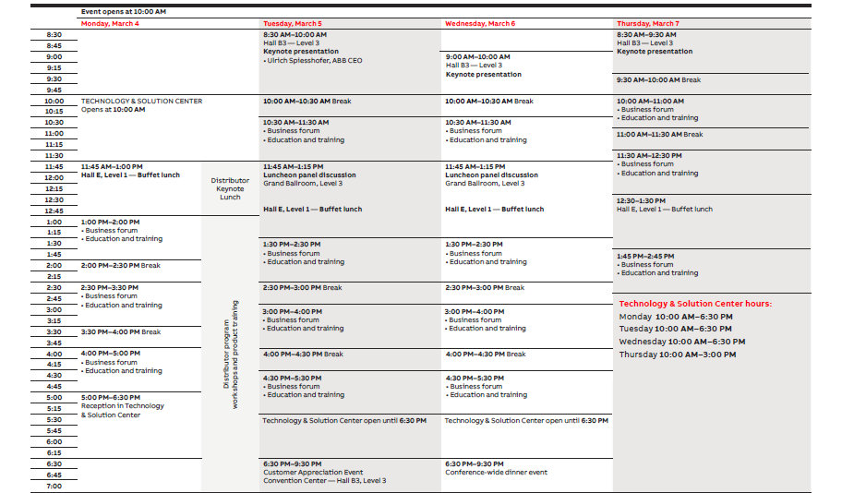
ABB Customer World 2019 | Agenda-at-a-glance

