Slide 1

Presentation title
ABB Customer World, March 13-16, 2017
Presentation code
Speaker, position

Slide 2
New PowerPoint master toolkit
Guidelines and instructions
Click here to download the full toolkit for additional slide layouts
Merging old and new presentations
  To add existing slides to a new presentation, copy-paste the text into the new format and adjust the font – including the bullet points and text color to our new ABBvoiceOffice.
  By copying only the text and not the entire slide, you ensure it transfers to the new layout. Copying the old slide in its entirety will maintain its original format, layout, and font.
New font
  ABB font - ABBvoiceOffice - is automatically integrated into the PowerPoint master toolkit for Windows computers with Microsoft Office, from the 2008 version on.
  If you are a Mac user, the integration of the font requires a separate installation. Contact branding.abbzh@ch.abb.com for more information.
Sending your PowerPoint presentation
  For external parties using a PC with Windows 2008 or newer, ABBvoiceOffice will still be embedded in the template pptx file.
  External parties using other Office versions will see the slides in Arial – a font of similar size and format as ABBvoiceOffice, assuring that the layout of the presentation is not disrupted.
Exporting PowerPoint presentations to PDF: File – Export – Save as PDF. (Don’t use File – Save As and change the file type – this will not preserve the font settings.)

Slide 3
Presentation title
Presentation code
Speakers
Photo
Speaker Name 1
  Speaker title
  Company name
  Location
Photo
Speaker Name 2 (Delete if less than 2 speakers)
  Speaker title
  Company name
  Location
Photo
Speaker Name 3 (Delete if less than 3 speakers)
  Speaker title
  Company name
  Location
Photo
Speaker Name 4 (Delete if less than 4 speakers)
  Speaker title
  Company name
  Location

Slide 4
Your safety is important to us
Please be aware of these emergency procedures
Emergency numbers: Dial 8087 from any house phone or (713) 853-8087 from any cell phone or outside line
In the event of an emergency please call the emergency numbers above... Do not dial 9-1-1 directly.
In the event of an alarm please proceed to the nearest exit, or utilize the appropriate exit as directed by Convention Center personnel.
Use the stairwells or escalators to evacuate and do not attempt to use the elevators.
Convention Center associates will be located throughout the public space to assist in directing guests toward the closest exit.
If evacuation is required, please be alert for handicapped or disabled persons who may need your assistance.
Do not re-enter the building until advised by Convention Center personnel or an “all clear” announcement is made

Slide 5
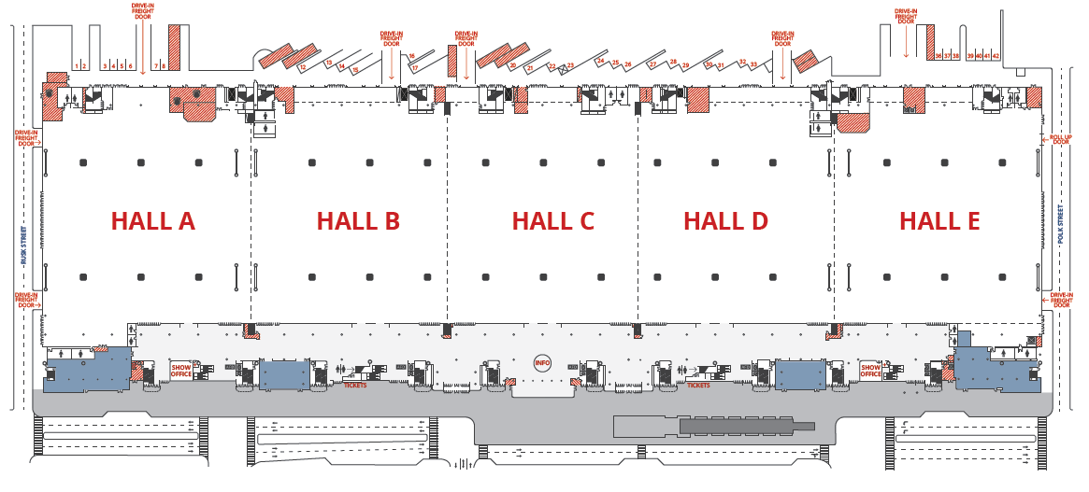
George R. Brown Convention Center
Assembly areas
Level one
Food & beverage
Technology & Solution Center

Slide 6
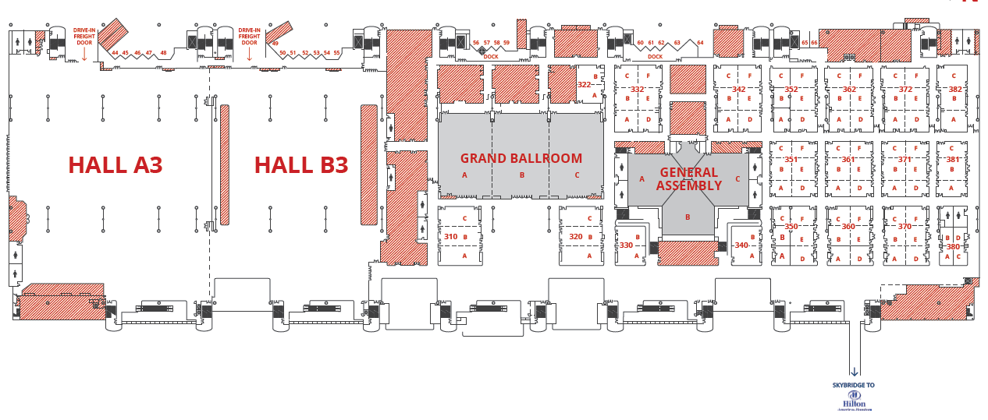
George R. Brown Convention Center
Level three: locate the nearest two exits
< EXIT >
< EXIT >
< EXIT >
< EXIT >
< EXIT >
< EXIT >
< EXIT >
< EXIT >
< EXIT >
< EXIT >
< EXIT >
< EXIT >
< EXIT >
< EXIT >
< EXIT >
< EXIT >
< EXIT >
< EXIT >
< EXIT >

Slide 7
YOUR SLIDES SHOULD BEGIN HERE

Slide 8
Q&A and Contact information
If you have questions, please contact me further
Speakers
Speaker Name 1
  Company name
  Contact phone
  Contact email
Speaker Name 2
  Company name
  Contact phone
  Contact email
Speaker Name 3
  Company name
  Contact phone
  Contact email
  (Delete if less than 3 speakers)
Speaker Name 4
  Company name
  Contact phone
  Contact email
  (Delete if less than 4 speakers)

Slide 9
Important reminders
ABB Customer World 2017
Workshop evaluation & Professional Development Hours
Badges are automatically scanned as you enter each classroom
  You can download a transcript of the workshops attended by visiting the event portal.
Please complete a workshop evaluation
  The workshop evaluation forms can be completed online via the downloadable event application on your smart device or PC.
  Each completed session survey will be entered into a drawing to win a $25 gift card. Ten gift cards will be awarded daily.

