Slide 1
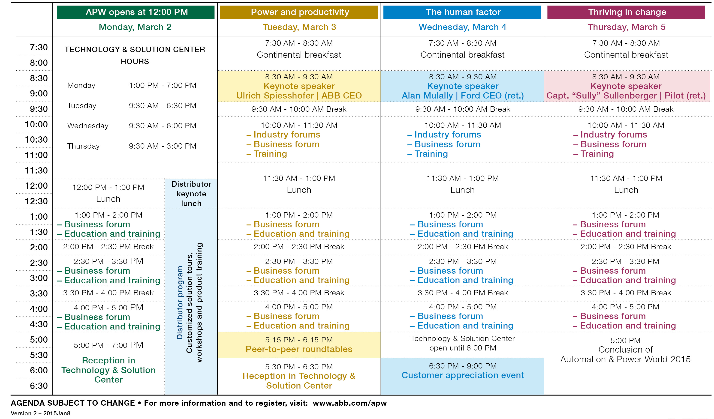
APW agenda-at-a glance
Featuring daily themes, less workshops and industry forums

