Slide 1
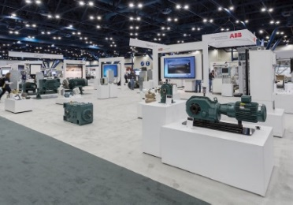
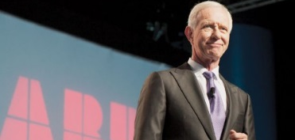
Save the date!
APW is now ABB Customer World: March 13 – 16, 2017
Distributor Day – Monday, March 13
Educational sessions
Tech. & solution center
Welcome reception Sunday, March 12
Distributor lunch with Greg Scheu, President, Americas region
Three hours of distributor focused content
  Executive leadership Q&A panel
  Selling ABB’s value in key market segments
  Selling ABB’s value in distribution product groups
Reception in the 120,000 sq. ft. exhibit hall
Training opportunity
for distributor employees and customers
300+ classes
PDH, CEU
Technical expertise
Daily keynotes
With all the experts you need, all under one roof, APW
is a great place to close orders and convert customers
Houston, TX

