Slide 1
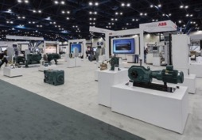
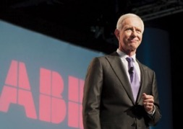
Save the date!
ABB Automation & Power World: March 13 – 16, 2017
Distributor Day – Monday, March 13
Educational sessions
Technology and solution center
Welcome reception Sunday, March 12
Distributor lunch with Greg Scheu, President, Americas region
Three hours of distributor focused content
  Executive leadership Q&A panel
  Selling ABB’s value in key market segments
  Selling ABB’s value in distribution product groups
Reception in the 120,000 sq. ft. exhibit hall
Training opportunity for distributor employees and customers
300+ classes
PDH, CEU
Daily keynotes
Technical expertise
With all the experts you need, all under one roof, APW is a great place to close orders and convert customers
Houston, TX

Slide 2

Automation & Power World 2017
March 13 – 16 Houston, TX
Save the date!

