Slide 1
Session title
Sub headline
Automation and Power World, Month, DD, 2016
Notes:
Moderator: Hello everyone and thank you for joining our session, << Name of presentation >>.
My name is <<First and Last name >> and I am today’s moderator.
Before we begin, let’s take a quick tour of the webcast console.
If you are experiencing any system issues, click the question mark icon located at the top right corner of your screen.
It will open a new tab in your browser with a menu of help options. To return to the main console, “x” out of the help browser tab.
To the left of the slides you’ll see three sections: Talk to an ABB Expert. Ask a Question. And Event Resources.
During the presentation, I suggest opening Ask a Question.
You can submit questions at any time by entering them here. Our speakers will address as many as possible at the end of their prepared remarks. If you are watching this on demand, you can still submit questions and they will be responded to via email.
Along the top of the presentation slides, you have three more tabs:
Slides. Speaker Bio’s. and About APW.
By default, “Slides” is already selected.
You can increase the slide viewing area by clicking on the double arrow at the top right of the slide window.
Clicking on it again will bring you back to the main console view.
Lastly, you will receive an attendance certificate by email at the end of the webcast after you submit our short 4 question post-session survey. If you cannot stay for the entire duration of the webcast you still may be eligible to receive your attendance certificate. If you must leave early, make sure you exit the webcast console by clicking the X at the top right of the screen. If you exit any other way you will not be served the post-session survey and we will not be able to issue you an attendance certificate.

Slide 2
Title of presentation
Presenters
Speaker name: Name here
Speaker title: Title here
Company name: Company name
Location: Location
Speaker photos
Speaker name: Name here
Speaker title: Title here
Company name: Company name
Location: Location
Notes:
Your presenters today include << name and title or summary statement about each presenter >>
Now I will turn it over to our first presenter, << name >>

Slide 3
Wrap Up

Slide 4
Wrap-up
Key takeaways
Key takeaway #1
Key takeaway #2
Key takeaway #3

Slide 5
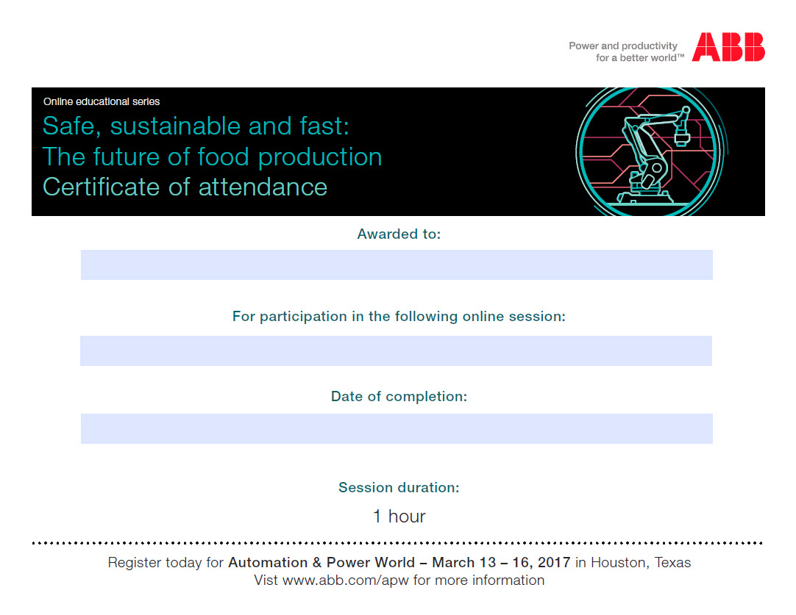
Get your certificate of attendance certificate now
New image to
Notes:
Moderator: Thank you << name of last speaker >>).
This concludes the presentation portion of our webcast. You can download a PDF of these slides and other relevant content in Event Resources.
While our speakers are reviewing the questions you’ve submitted, I’d like to remind you that in order to receive your attendance certificate you will need to fill out the short post-session survey that will be pushed to you after the Q&A session. If you need to leave early, make sure you close the webcast console by clicking the “x” in the top right corner of the console. If you close the console any other way, the post-session survey will NOT be pushed to you and you will NOT receive your attendance certificate.

Slide 6
Q&A
Industry picture
Contact information
[Speaker name]
[Speaker title]
[Company name]
[Email address]
[Speaker name]
[Speaker title]
[Company name]
[Email address]
Notes:
(IF YOU HAVE TIME FOR Q&A )
Moderator: Now let’s spend a few minutes answering some of the questions we received during our session. If you’d like to ask a question, you can still enter it into the Ask a Question section. We will answer as many as we have time for but need to stop promptly at five minutes before the top of the hour. If you are watching a recording of today’s webcast, you can still submit questions here and they will be answered via email.
(Q&A SESSION)
(AFTER Q&A)
Looks like that’s all the time we have today. Everyone who joined our session live will receive an email in the next couple of weeks with a summary of all the Q&A sessions from all nine of today’s webcasts. If your question wasn’t covered live, it will be addressed here.
(NO TIME FOR Q&A )
I’m afraid we don’t have time for Q&A. If you submitted a question during our live webcast, it will be answered in a follow up email in the next couple of weeks, along with a summary of Q&A from all nine of today’s webcast’s.

Slide 7

Automation and Power World 2017
Connect. Collaborate. Outperform.
Save the date
Save the date for this must attend event
March 13-16, 2017 | Houston, Texas
Be part of ABB’s largest educational experience
in North America
120,000 sq ft Technology & Solution Center - see it all in
one place: products, experts, solutions
Daily keynote headline sessions
Educational and training opportunities:
  Customer case studies
  Hands-on training and technical workshops
  Panel discussions
  Business forum
Stay connected: www.abb.com/apw
Notes:
Thank you for your Joining us today. Don’t forget to mark your calendar for APW 2017. Held every other year, APW is ABB’[s largest educational experience in North America.
You’ll see the latest technologies, participate in technical workshops, meet industry experts and more at this must-attend event. Registration is free. We hope to see you there.

Slide 8
Notes:
When you click on the “x” at the top right hand part of the screen to exit today’s session, you will be presented with a very brief survey. Please take a few moments to let us know how we did. Have a great day.
Thank you.

Slide 9
Slide resources

Slide 10
Insert Title (1st blue color)
Insert Subtitle (2nd blue color)
(First list level for Bulletpoint 01), Arial 18pt
  (Second list level for Bulletpoint 02), Arial 18pt
    (Third list level for Bulletpoint 03), Arial 16pt
      (Fourth level for running text), Arial 18pt
        Highlight 01 (Fifth list level), Arial 18pt, bold
          Highlight 02 (Sixth list level) Arial 18pt, bold, 2nd blue

Slide 11
Headline
Title
Title
Title
Text
Text
Text
Text
Text
on 2 lines
Text
continued
on 3 lines
Text
  Text
Text
  Text
  on 2 lines

Slide 12
Picture + Text
Title
Title
Title
Title

Slide 13
Tables
Text | Text | Text | Text | Text | Text | Text | Text | Text | Text | Text | Text | Text
Text | Text | Text | Text | Text | Text | Text | Text | Text | Text | Text | Text | Text
Text | Text | Text | Text | Text | Text | Text | Text | Text | Text | Text | Text | Text
Text | Text | Text | Text | Text | Text | Text | Text | Text | Text | Text | Text | Text
Text | Text | Text | Text | Text | Text | Text | Text | Text | Text | Text | Text | Text
Text | Text | Text | Text | Text | Text | Text | Text | Text | Text | Text | Text | Text
Text | Text | Text | Text | Text | Text | Text | Text | Text | Text | Text | Text | Text
Text | Text | Text | Text | Text | Text | Text | Text | Text | Text | Text | Text | Text

Slide 14
Tables
 | Text | Text | Text
Text
Text
Text
Text
Text
Text
Text
Text

Slide 15
Tables
Text | Text
Text | Text
Text | Text
Text | Text
Text | Text
Text | Text
Text | Text
Text | Text
Text | Text

Slide 16
Diagrams
CAGR 2005-08: +8.8%
+7.1% pa
4'316
+5.3% pa
4'072
3'805
3'542
3'302
2'874
3'043
3'059
2'610
2'825
2'362

Slide 17
Diagrams

Slide 18
Diagrams
Text
Text
Text
Text
Text

Slide 19
Schematic drawings
Text
Text
Text
Text
Text
Text
Text
Text
Text
Text
Text
Text
Text
Text
Text
Text
Text
Text
Text
Text
Text
Text
Text
Text
Text
Text
Text
Text
Text
Text
Text
Text
Text
Text
Text
Text
Text
Text
Text
Text
Text
Text
Text
Text
Text
Text
Text
Text
Text
Text
Text
Text

Slide 20
Schematic drawings
Text
(Text)
Text
Text
Text
Text
(Text)
Text
Text
Text
Text
(Text)
Text
Text
Text
Text
Text
Text
Text
Text

Slide 21
Schematic drawings
Text…from…
…to…Text
Text
Text
Text
Text
Text
on 2 lines
Text
continued
on 3 lines

Slide 22
Schematic drawings
Text
Text
Text
Text
Text
Text
Text
Text
Text
Text
Text
Text

Slide 23
Icons / Graphics
Use these icons to visualize your content

Slide 24
Icons / Graphics
Lines and Boxes for drawings
!
?
1
2
3
4
5
6
7
8
9
0
–
+

Slide 25
Icons / Graphics
Industrie 4.0

Slide 26
Icons / Graphics
Industrie 4.0

Slide 27
Icons / Graphics
Industrie 4.0
Sicherheit
Effizienz

