Slide 1

Automation & Power World 2015
Harnessing the power of change
March 2-5, 2015 | Houston, Texas

Slide 2
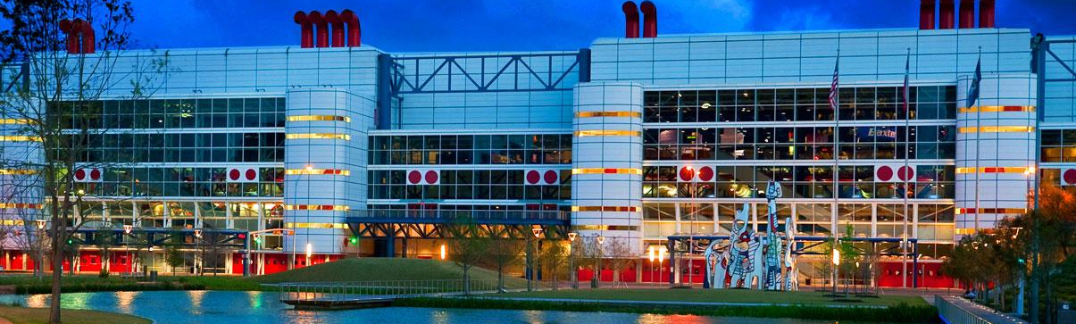
Automation & Power World
Harnessing the power of change
March 2-5, 2015
George R. Brown Convention Center in Houston, Texas
For more information and to register, visit us at:
www.abb.com/apw/2015

Slide 3
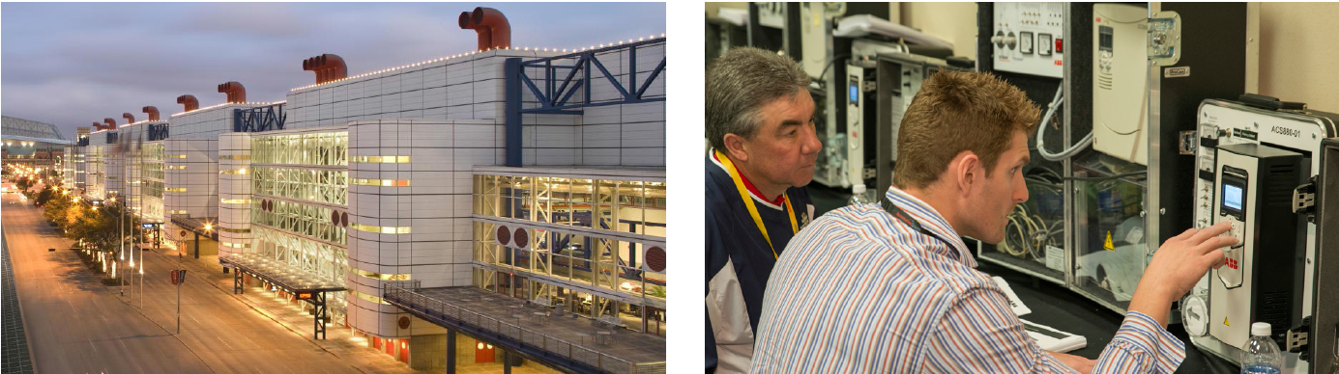
Automation & Power World
What’s new in 2015?
No charge to attend!
Headline keynoters and luncheon
general sessions
Industry forums
Educational framework
Redesigned Technology & Solution Center
Distributor Day
STEM activities
Peer-to-peer discussions

Slide 4
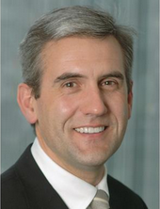
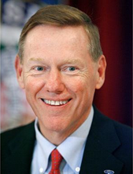
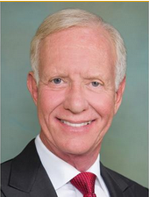
What’s new
Headline keynoters
Tuesday
Power & Productivity
Wednesday
The Human Factor
Thursday
Thriving in Change
Ulrich Spiesshofer
ABB CEO
Alan Mulally
Ford CEO, retired
Captain Sullenberger

Slide 5


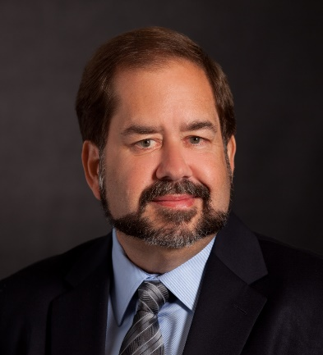
What’s new
Luncheon general sessions
Tuesday General Luncheon session
Internet of Things starts with your things
Norm Judah,
CTO, Microsoft Services
Wednesday General Luncheon session
Cybersecurity in the evolving
threat landscape
Mike Quinn,
General Manager, Cybersecurity and Data Protection,
Microsoft Enterprise & Partner Group

Slide 6





What’s new
Industry Forums
Industry forums are focused on timely and important issues unique to specific markets. Designed to facilitate peer-to-peer dialogue and problem solving of challenges unique to these industries, forum speakers and panelists come from many organizations, including:
Featured industries:
Oil, gas and chemicals
Data Centers
Manufacturing
Marine
Metals
Mining and minerals
Power generation
Pulp and paper
Transmission and distribution
Water and waste water
Wind and solar energy
Ameren
Exxon
Dominion
Pepco
AWEA
SEIA
Intel
NEMA
Burns & McDonnell
City of Houston
AWWA
Schlumberger

Slide 7

Curriculum
More hands-on training, best practices & applications
Programs and tracks include:
Business forum
  Business trends and professional development
  Effective project management
Applications and best practices: Industry
  Innovations in automation technology
  Maintenance strategies
  Optimizing plant assets
  Process safety
  Transforming operations
Applications and best practices: Utilities
  Asset management
  Distributed energy resources and renewables
  Grid modernization
  Reliability and resiliency
  Safety and regulatory compliance
Applications and best practices: Infrastructure
  Lean construction
  Solving information and transportation challenges
Technical training: Hands-on experience
New and updated products
The APW 2015 conference curriculum features applications and best practices workshop tracks, new product and product updates tracks, and hands on training. PDHs are available for all sessions and some select sessions offer CEUs to participants.
Click here to search curriculum now!

Slide 8
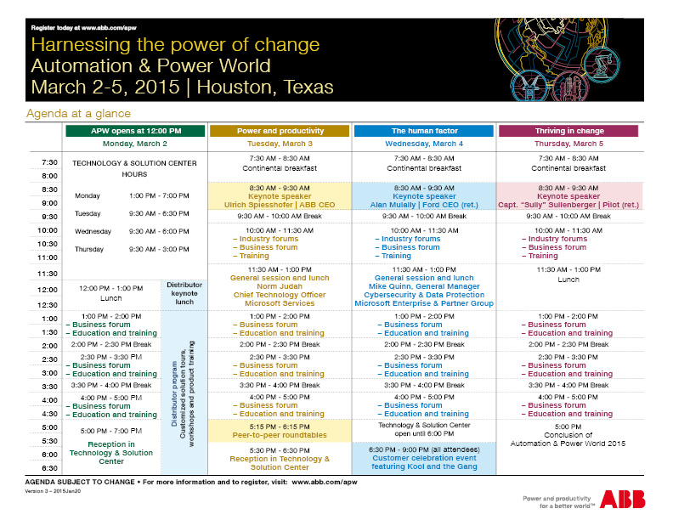
APW agenda-at-a glance
Featuring daily themes, less workshops and industry forums

Slide 9
Automation & Power World
Stay informed
ABB Automation & Power World website: http://new.abb.com/apw/2015
Join the Automation & Power World mailing list: http://autoandpower.com/157
Automation & Power World on social media:
  YouTube channel – includes recorded workshops from the live events as well as pre-event webinars: https://www.youtube.com/user/abbapworld/featured
  LinkedIn group: https://www.linkedin.com/groups?home=&gid=2723725
  Facebook page: https://www.facebook.com/abbapworld
  Twitter: http://twitter.com/abb_APW
Any questions? Contact your account manager or Tracey Noble (tracey.noble@us.abb.com)

