Slide 1

Presentation code
Presentation title
Title maximum is 2 lines
ABB Automation & Power World: March 2-5, 2015

Slide 2
Presentation code
Title of presentation
Speaker name: Name here
Speaker title: Title here
Company name: Company name
Location: Location
Co-presenter (if applicable)
Speaker name: Name here
Speaker title: Title here
Company name: Company name
Location: Location

Slide 3
Headline on this line – maximum one line
Subhead on this line – maximum one line
Bullet points begin here
The standard font size is 18 pt. This text is shown in black. Several font size options are possible.
  The standard font size is 18 pt.
    This text is shown in black. This font size is 16 pt.
      This text is shown in black. This font size is 14 pt.

Slide 4
Please include the
following safety slides.
Add the next three slides
to your presentation and review at the beginning
of your workshop.
NOTE: This page can be updated and used as a divider slide.
Text can be no longer than six (6) lines in length.

Slide 5
Your safety is important to us
Please be aware of these emergency procedures
Emergency numbers: Dial 8087 from any house phone
or (713) 853-8087 from any cell phone or outside line
In the event of an emergency please call the emergency numbers above...
Do not dial 9-1-1 directly.
In the event of an alarm please proceed carefully to the nearest exit or the appropriate exit
as directed by Convention Center personnel.
Use the stairwells or escalators to evacuate and do not attempt to use the elevators.
Convention Center associates will be located throughout the public space to assist
in directing guests toward the closest exit.
If evacuation is required, please be alert for handicapped or disabled persons
who may need your assistance.
Do not re-enter the building until advised by Convention Center personnel or an
“all clear” announcement is made.

Slide 6
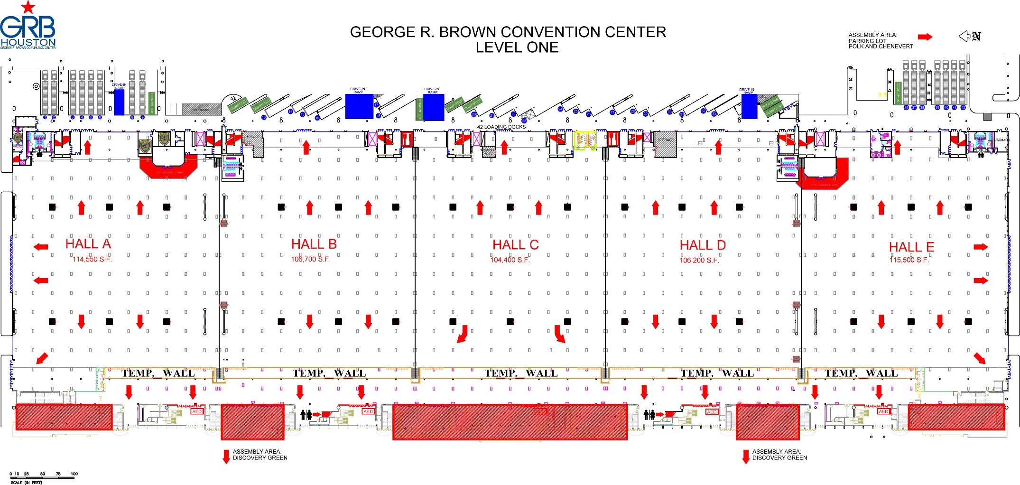
George R. Brown Convention Center
Level one
Know your surroundings:
Identify the area you are in
Locate the nearest two exits

Slide 7
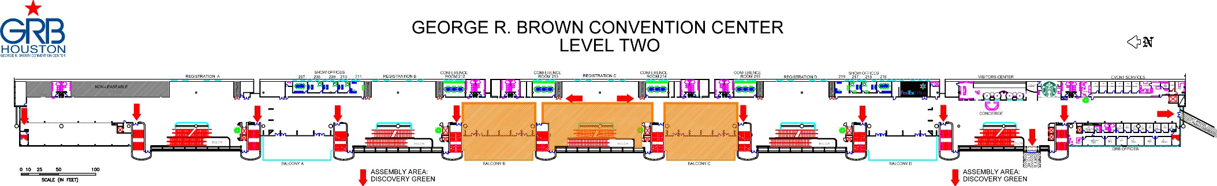
George R. Brown Convention Center
Level two
Know your surroundings:
Identify the area you are in
Locate the nearest two exits

Slide 8
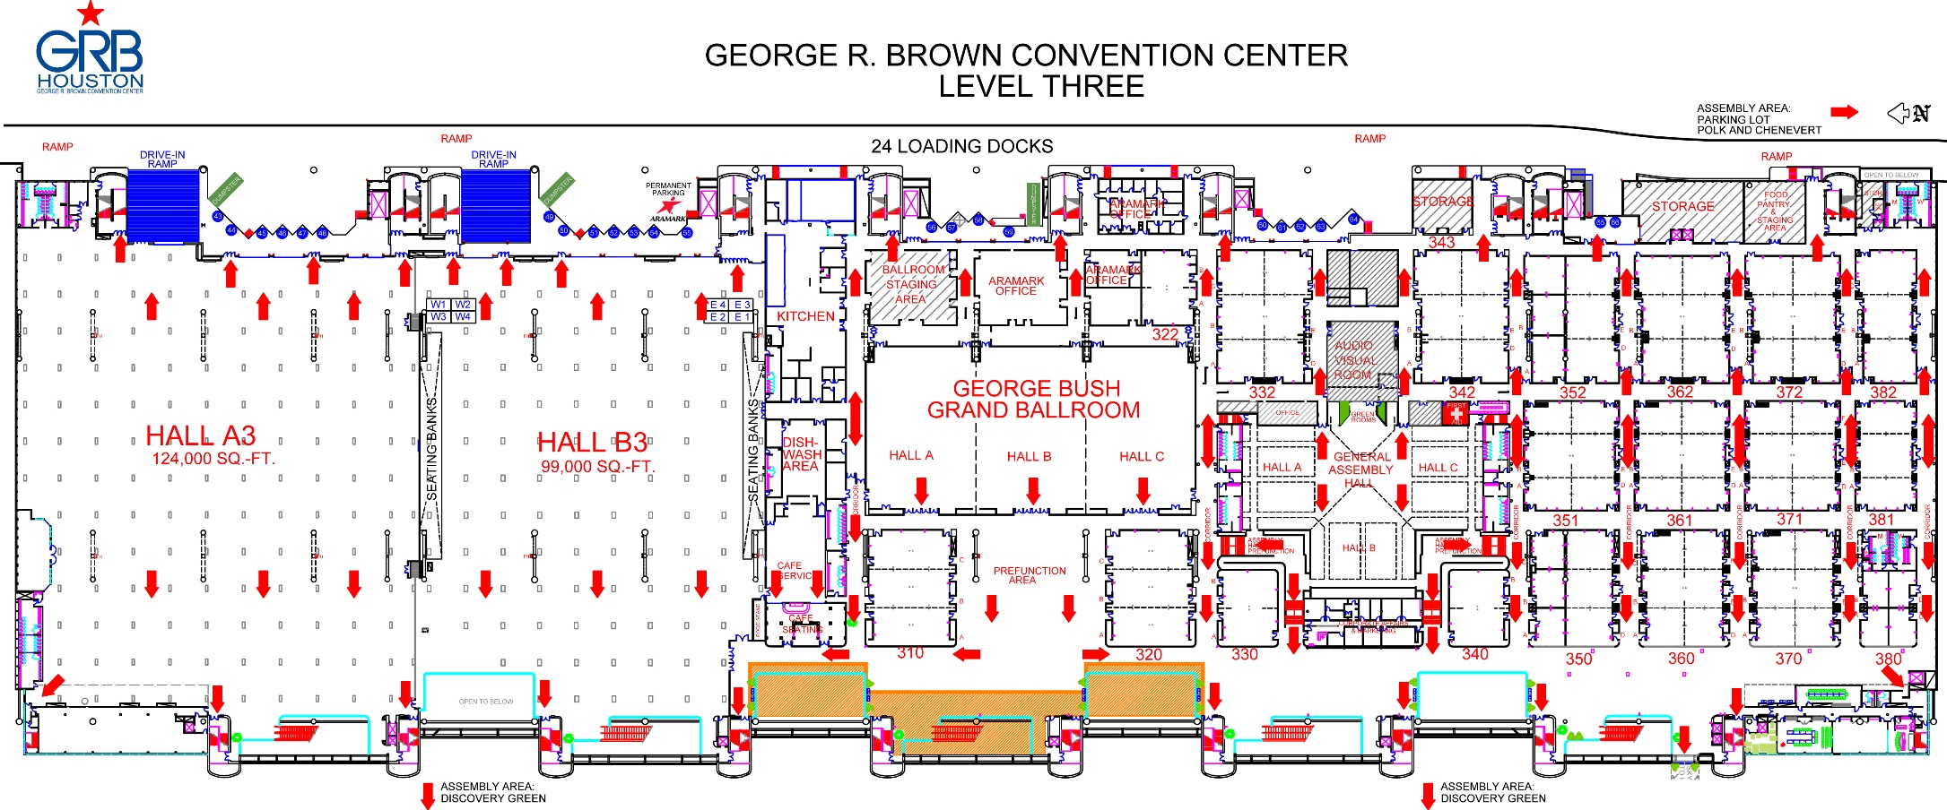
George R. Brown Convention Center
Level three
Know your surroundings:
Identify the meeting room you are in
Locate the nearest two exits

Slide 9
Please include the
following slide.
The next slide should be
added to your presentation
and displayed during your
Q&A period.

Slide 10
Important reminders
Automation & Power World 2015
Badges are automatically scanned as you enter each classroom
Please complete a workshop evaluation
  The workshop evaluation forms can be completed online via the downloadable
  event application on your smart device or PC.
  ABB will donate $1 USD for each completed session survey to this year’s charity.
  Each completed session survey will also be entered into a drawing to win a $25 gift
  card. Ten gift cards will be awarded daily.
Professional Development Hours and Continuing Education Credits (CEUs)
You may obtain and print a transcript for all workshops attended during the event
by logging in to the Automation & Power World portal. You must attend a workshop
in its entirety in order to obtain PDH and CEU credentials.

Slide 11
Contact information
The following slide should
be completed by the speaker(s) and inserted into the presentation.

Slide 12
Contact information
If you have further questions , please contact me at:
PRESENTER Your name
COMPANY Company name
CONTACT PHONE (xxx) xxx-xxxx
CONTACT E-MAIL @xxx.com

Slide 13
Final closing slide
The following slide should
be used as your closing
slide.

Slide 14


Slide 15
Need assistance with your presentation?
There are various presentation tools posted in the
APW Promotion-in-a-box toolkit.
http://new.abb.com/apw/promotion-in-a-box

