Slide 1
Please include the
following safety slides.
Add the next four slides
to your presentation and review at the beginning
of your workshop.
NOTE: This page can be updated and used as a divider slide.
Text can be no longer than six (6) lines in length.

Slide 2
Your safety is important to us
Please be aware of these emergency procedures
Emergency numbers: Dial 8087 from any house phone
or (713) 853-8087 from any cell phone or outside line
In the event of an emergency please call the emergency numbers above...
Do not dial 9-1-1 directly.
In the event of an alarm please proceed carefully to the nearest exit or the appropriate exit
as directed by Convention Center personnel.
Use the stairwells or escalators to evacuate and do not attempt to use the elevators.
Convention Center associates will be located throughout the public space to assist
in directing guests toward the closest exit.
If evacuation is required, please be alert for handicapped or disabled persons
who may need your assistance.
Do not re-enter the building until advised by Convention Center personnel or an
“all clear” announcement is made.

Slide 3
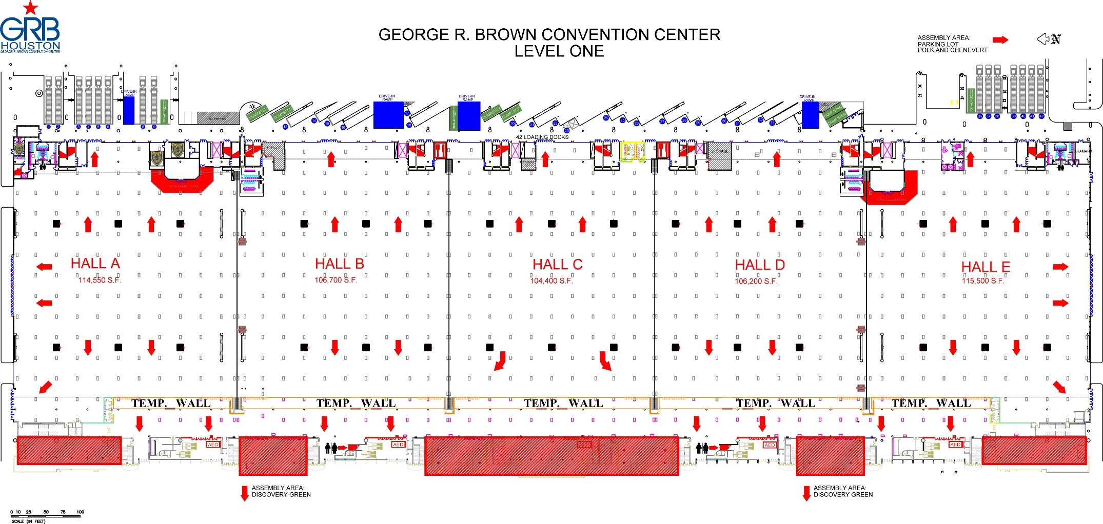
George R. Brown Convention Center
Level one
Know your surroundings:
Identify the area you are in
Locate the nearest two exits

Slide 4
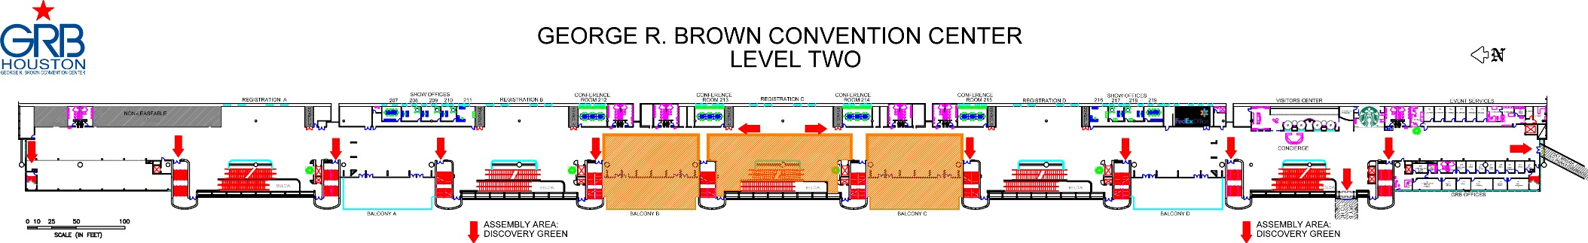
George R. Brown Convention Center
Level two
Know your surroundings:
Identify the area you are in
Locate the nearest two exits

Slide 5
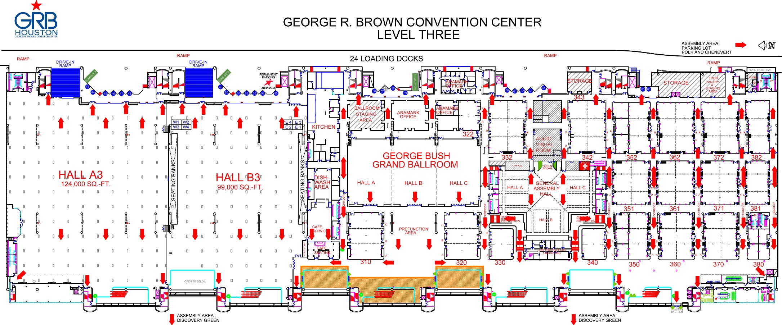
George R. Brown Convention Center
Level three
Know your surroundings:
Identify the meeting room you are in
Locate the nearest two exits

