Slide 2

Our mission is to be the best (as determined by our customers) marketers, designers and manufacturers of industrial electric motors, drives and mechanical power transmission products
Taking care of our customers safely

Slide 3

Our Strategy
To produce the highest quality, energy-efficient products available in the marketplace and sell them to a broad base of value-minded customers.
Vp = perceived Value Qp = perceived Quality Sp = perceived Service
C = Cost T = Time

Slide 4
Presentation code
Title of presentation
Speaker name: Name here
Speaker title: Title here
Company name: Company name
Location: Location
Co-presenter (if applicable)
Speaker name: Name here
Speaker title: Title here
Company name: Company name
Location: Location

Slide 5
Headline on this line – maximum one line
Subhead on this line – maximum one line
Bullet points begin here
The standard font size is 18 pt. This text is shown in black. Several font size options are possible.
  The standard font size is 18 pt.
    This text is shown in black. This font size is 16 pt.
      This text is shown in black. This font size is 14 pt.

Slide 6
Please include the
following safety slides.
Add the next three slides
to your presentation and review at the beginning
of your workshop.
NOTE: This page can be updated and used as a divider slide.
Text can be no longer than six (6) lines in length.

Slide 7
Your safety is important to us
Please be aware of these emergency procedures
Emergency numbers: Dial 8087 from any house phone
or (713) 853-8087 from any cell phone or outside line
In the event of an emergency please call the emergency numbers above...
Do not dial 9-1-1 directly.
In the event of an alarm please proceed carefully to the nearest exit or the appropriate exit
as directed by Convention Center personnel.
Use the stairwells or escalators to evacuate and do not attempt to use the elevators.
Convention Center associates will be located throughout the public space to assist
in directing guests toward the closest exit.
If evacuation is required, please be alert for handicapped or disabled persons
who may need your assistance.
Do not re-enter the building until advised by Convention Center personnel or an
“all clear” announcement is made.

Slide 8
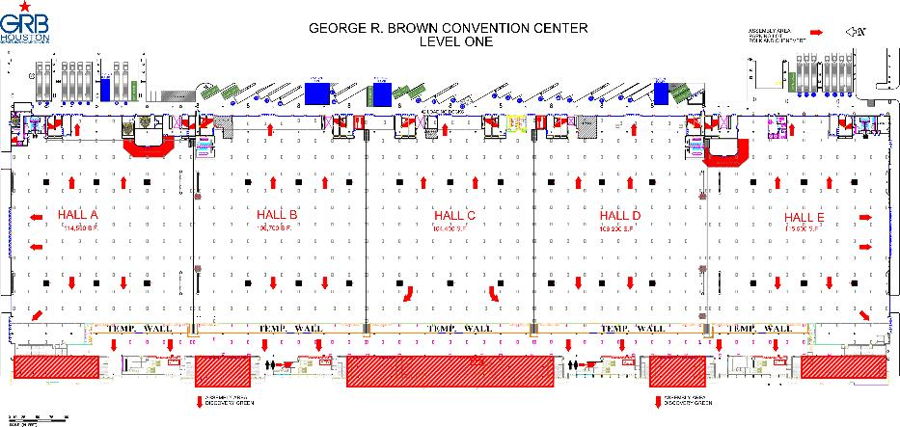
George R. Brown Convention Center
Level one
Know your surroundings:
Identify the area you are in
Locate the nearest two exits

Slide 9
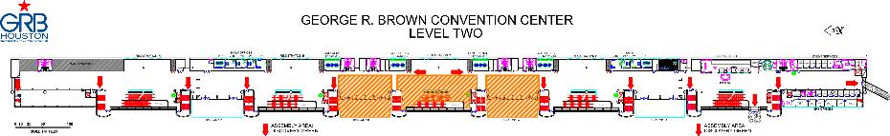
George R. Brown Convention Center
Level two
Know your surroundings:
Identify the area you are in
Locate the nearest two exits

Slide 10
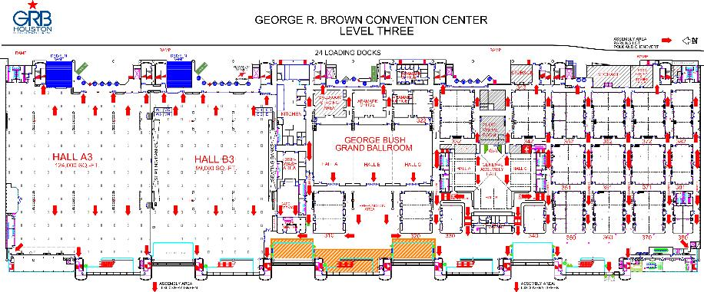
George R. Brown Convention Center
Level three
Know your surroundings:
Identify the meeting room you are in
Locate the nearest two exits

Slide 11
Please include the
following slide.
The next slide should be
added to your presentation
and displayed during your
Q&A period.

Slide 12
Important reminders
Automation & Power World 2015
Badges are automatically scanned as you enter each classroom
Please complete a workshop evaluation
  The workshop evaluation forms can be completed online via the downloadable
  event application on your smart device or PC.
  ABB will donate $1 USD for each completed session survey to this year’s charity.
  Each completed session survey will also be entered into a drawing to win a $25 gift
  card. Ten gift cards will be awarded daily.
Professional Development Hours and Continuing Education Credits (CEUs)
You may obtain and print a transcript for all workshops attended during the event by logging in to the Automation & Power World portal. You must attend a workshop in its entirety in order to obtain PDH and CEU credentials.

Slide 13
Contact information
The following slide should
be completed by the speaker(s) and inserted into the presentation.

Slide 14
Contact information
If you have further questions , please contact me at:
PRESENTER Your name
COMPANY Company name
CONTACT PHONE (xxx) xxx-xxxx
CONTACT E-MAIL @xxx.com

Slide 15
Final closing slide
The following slide should
be used as your closing
slide.

Slide 16


Slide 17
Need assistance with your presentation?
There are various presentation tools posted in the
APW Promotion-in-a-box toolkit.
http://new.abb.com/apw/promotion-in-a-box

Slide 18
Example slides
The following slides are
examples of various
charts and graphs.
Use as reference only.

Slide 19
Tabular Data Example
Heading | Heading | Heading | Heading | Heading
Data | Data | Data | Data | Data
Data | Data | Data | Data | Data
Data | Data | Data | Data | Data

Slide 20
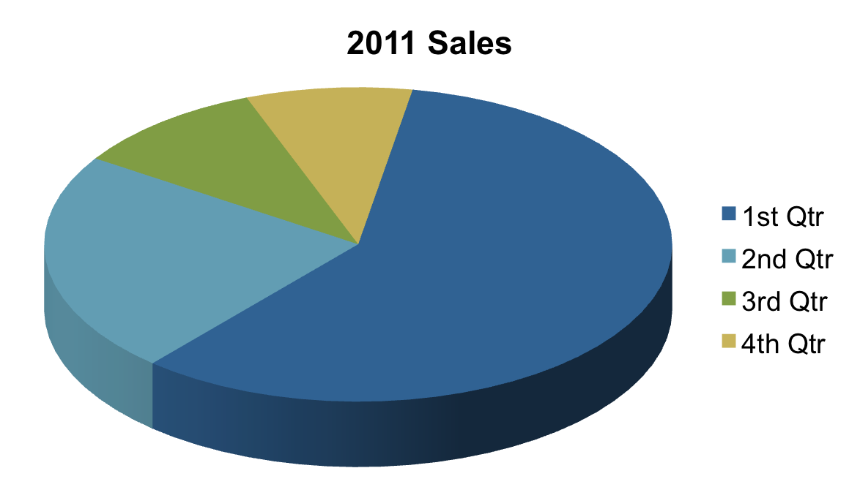
Pie Chart Example

Slide 21
Basic Venn Chart Example
Area A description here.
Area B description here.
Area C description here.
Area A
Area C
Area B

Slide 22
Block Cycle Example
Process 1
Process 2
Process 3
Process 4
Process 5

