Slide 1
Preparing for the power evolution
Copy + Paste toolkit
ABB Automation & Power World’s SmartStream digital conference

Slide 2
Power evolution infographics

Slide 3
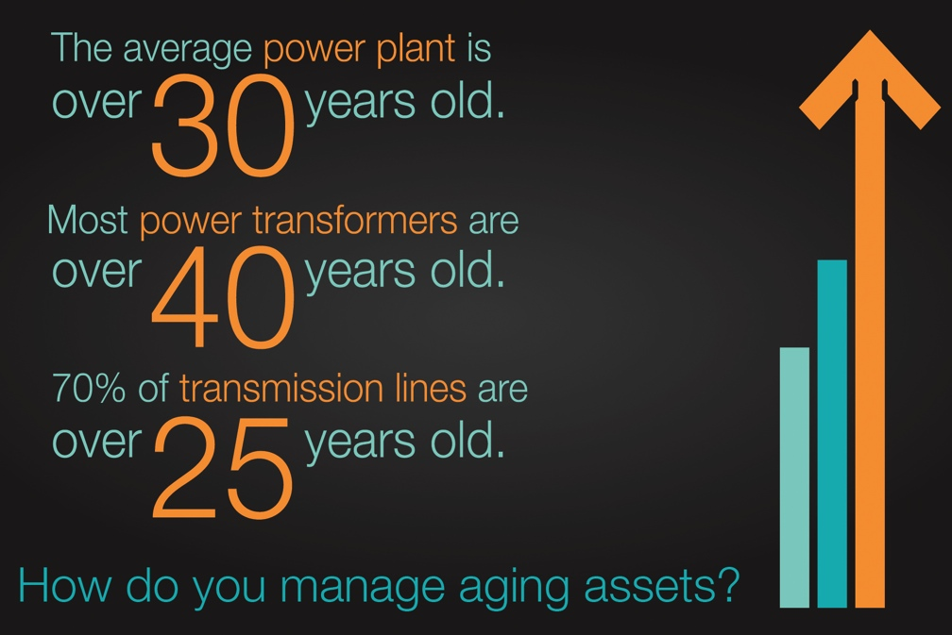




Slide 4

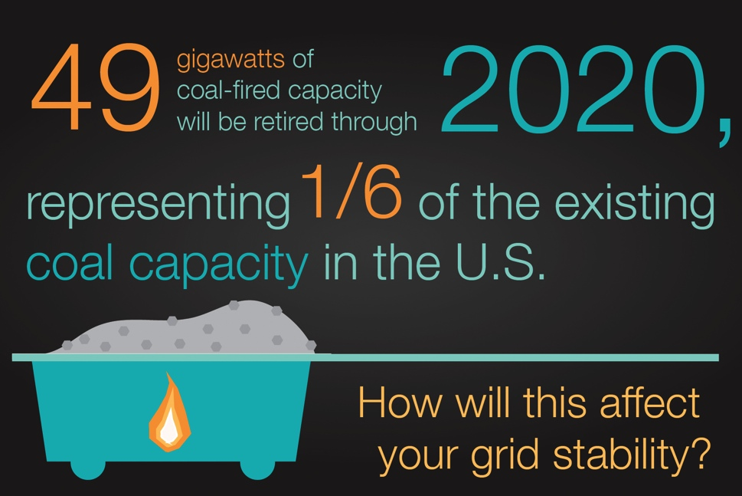
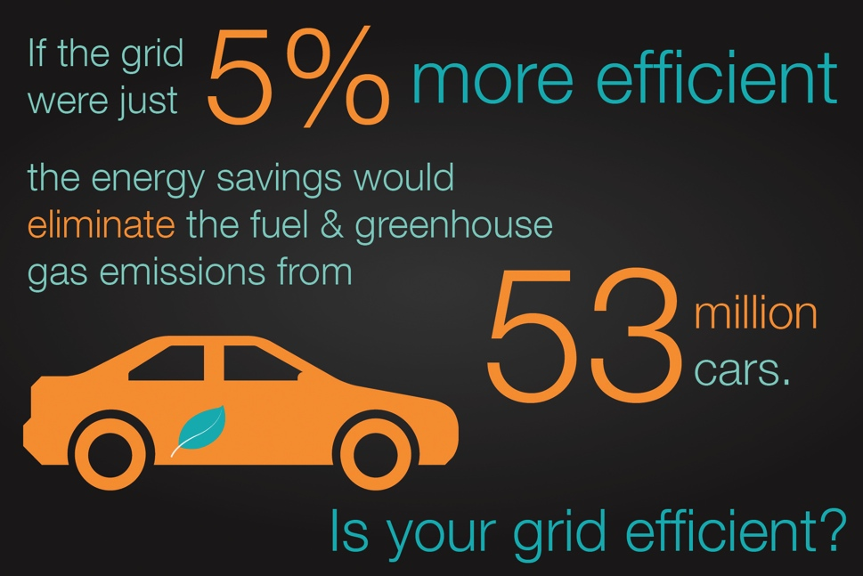


Slide 5
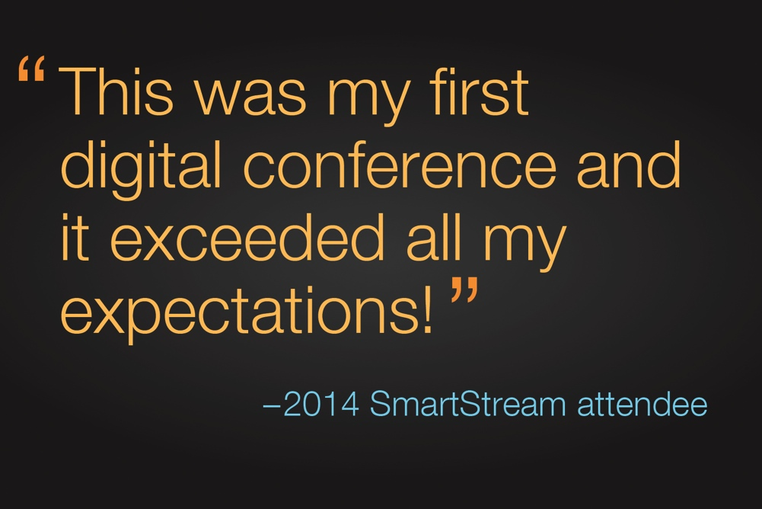
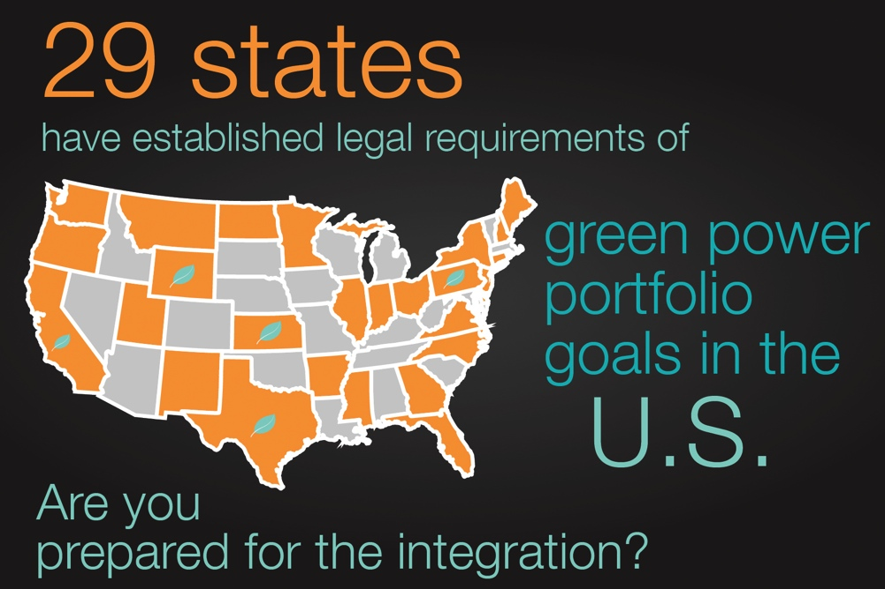

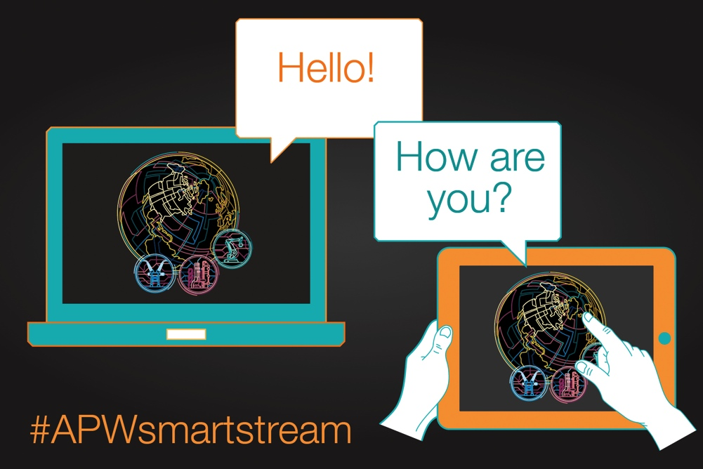

Slide 6
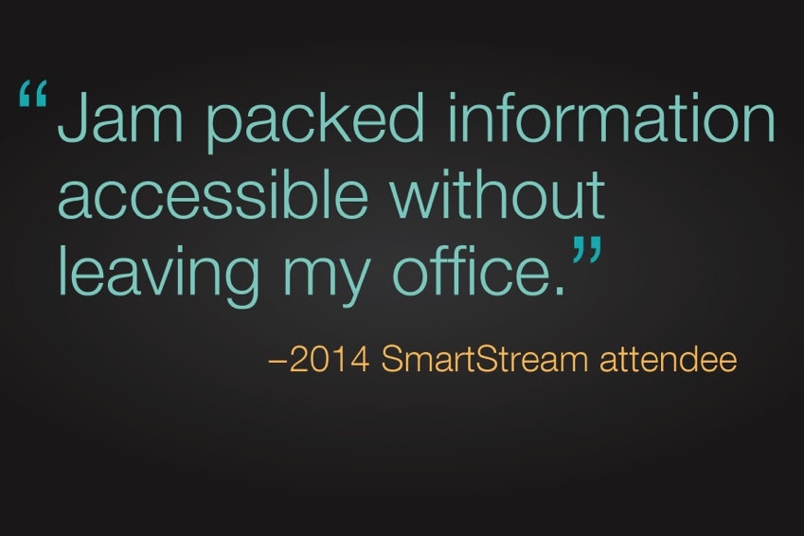
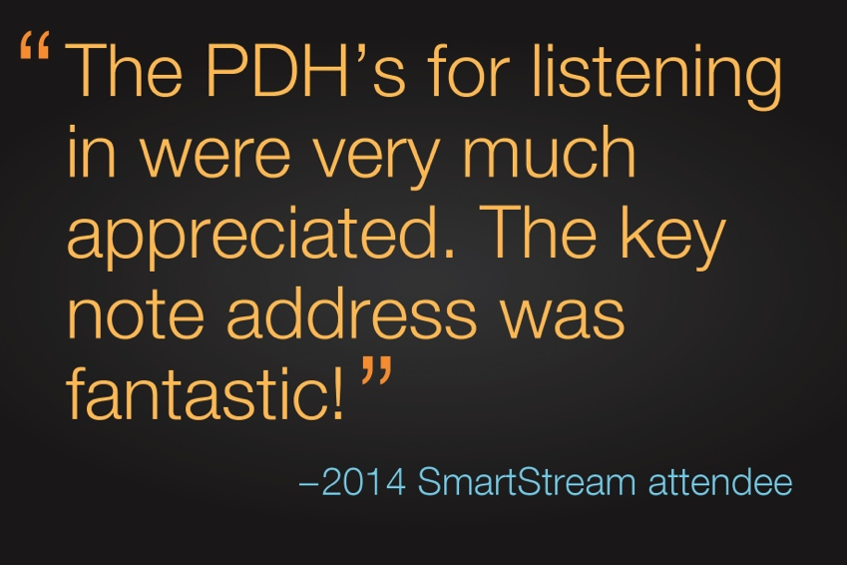



Slide 7


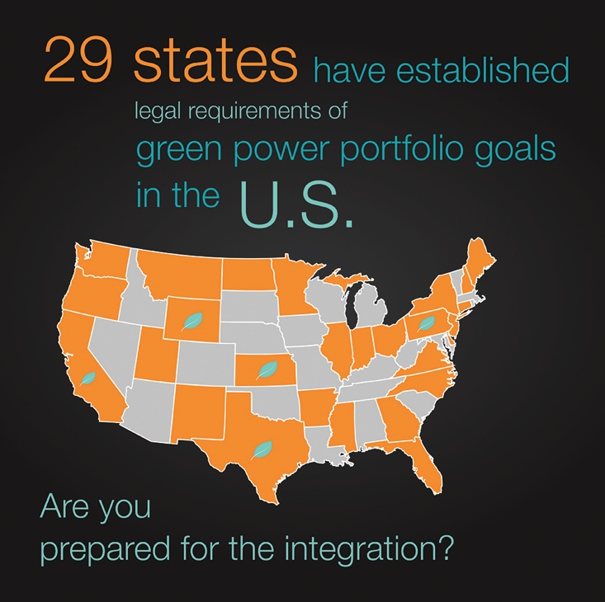


Slide 8
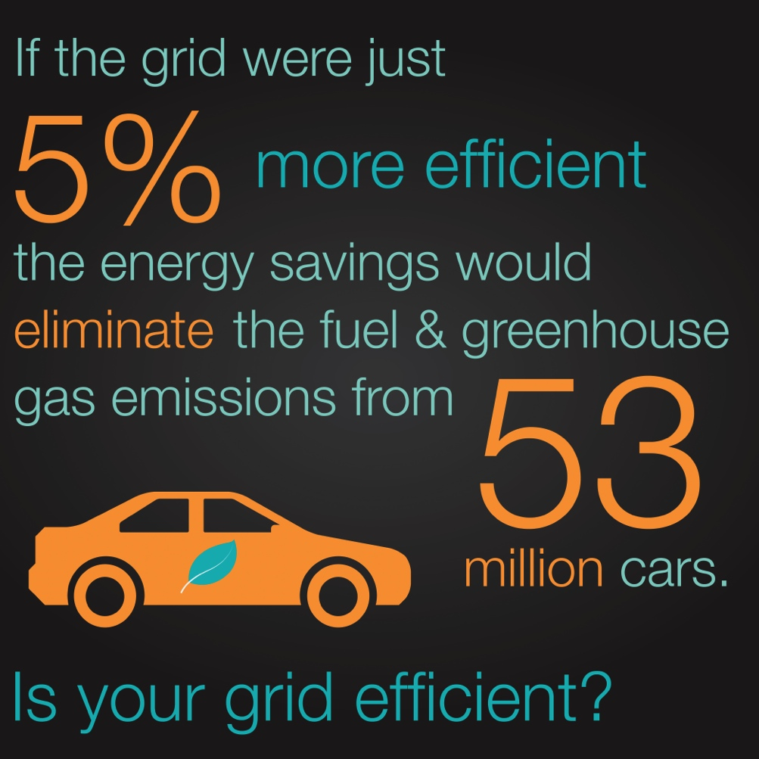


Slide 9
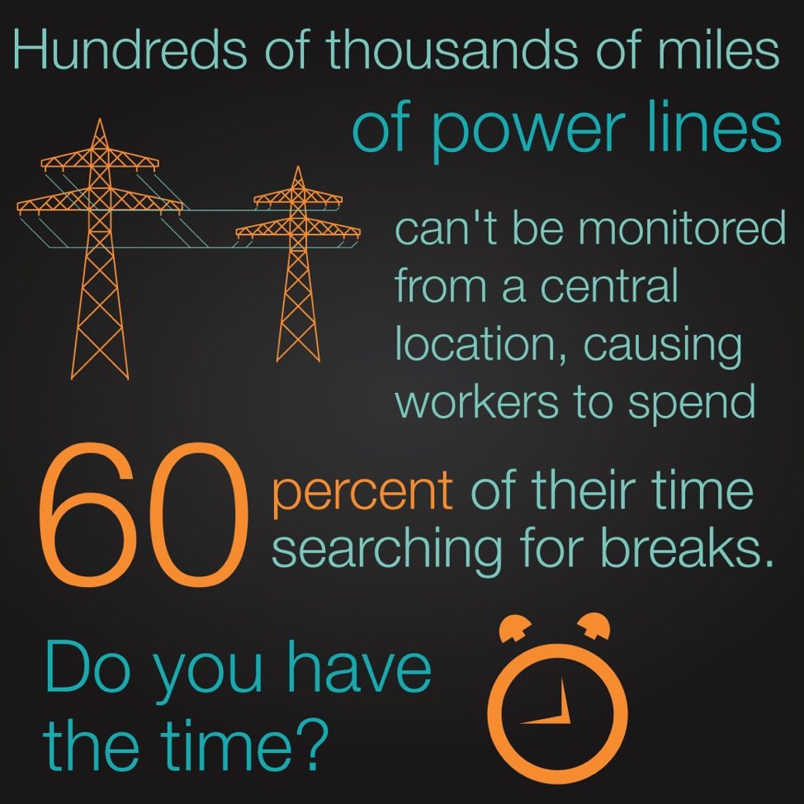
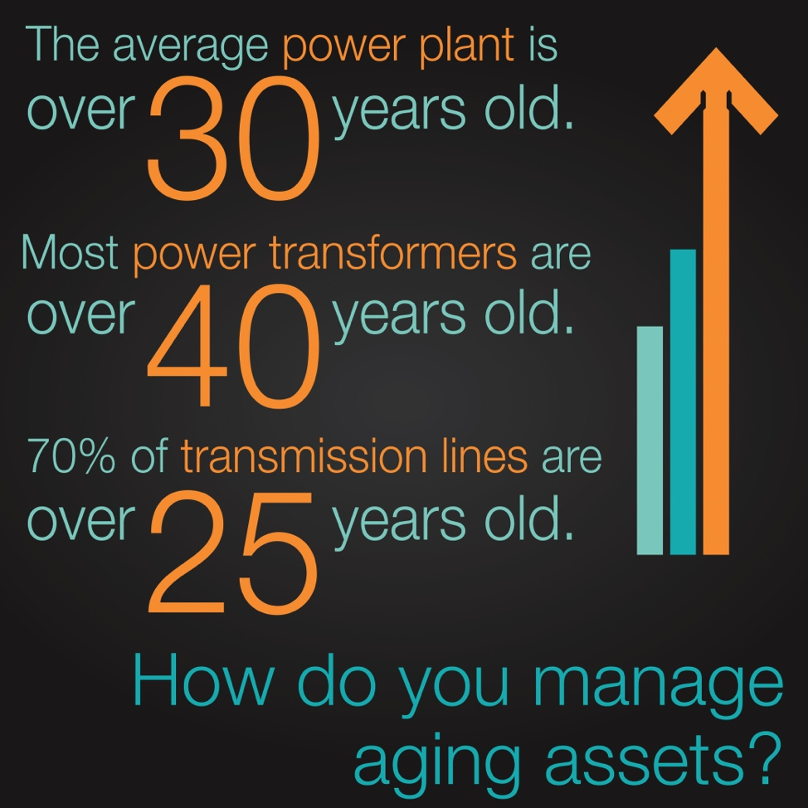

Slide 10
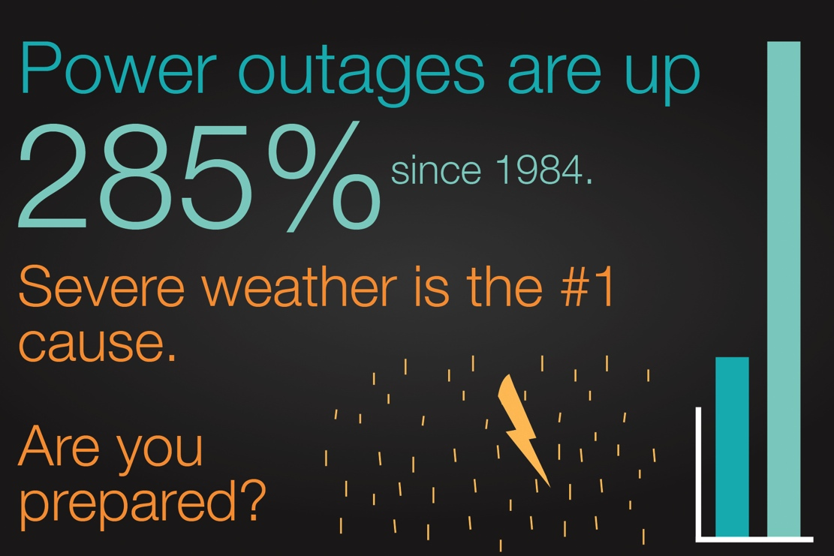

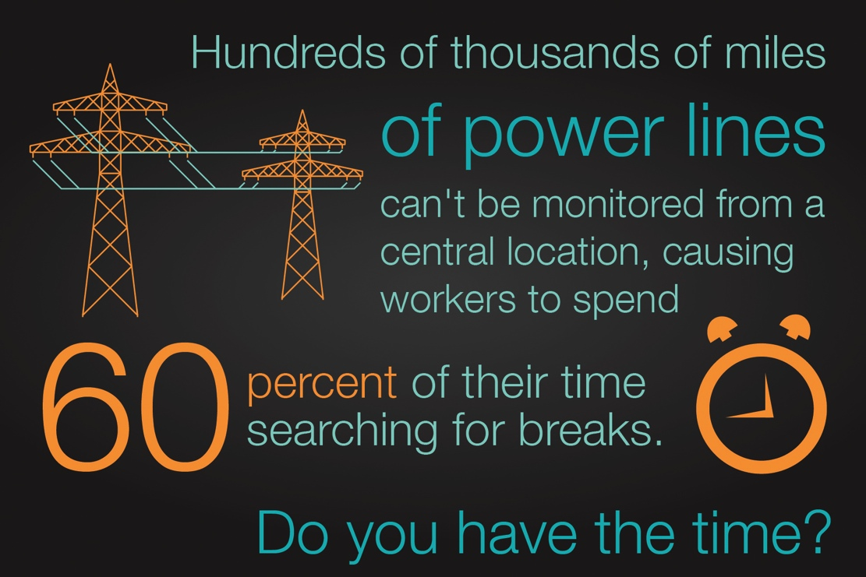


Slide 11
Icons / Graphics

Slide 12
Icons / Graphics
Use these icons to visualize your content

Slide 13
Icons / Graphics
Lines and Boxes for drawings
!
?
1
2
3
4
5
6
7
8
9
0
–
+

Slide 14
Icons / Graphics
Industrie 4.0

Slide 15
Icons / Graphics
Industrie 4.0

Slide 16
Icons / Graphics
Industrie 4.0
Sicherheit
Effizienz

Slide 17


Icons + Graphs

