Slide 1

APW has a new name
Webinar

Slide 2
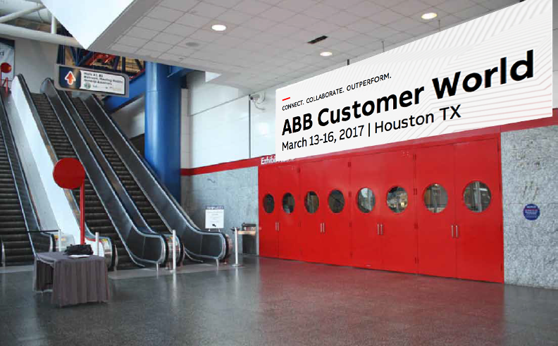
A new name for APW for Houston 2017
Notes:
On the 1st February, Wednesday this week, we will be making an important public announcement about APW
We are excited to introduce the new name for APW, ABB Customer World.

Slide 3
Three reasons why ‘Customer World’
ABB is much more than power and automation.
The ABB offer has grown beyond automation and power and, over the years, APW has extended to include all of these changes. Today, especially with the increasing role of digitalization, the name just can’t stretch anymore.
The APW customer is looking for more than Power & Automation
The world has also changed for our customers and, more than ever, they are looking to us for help in being prepared for the digital industrial future.
APW (and ABB) has always been about the customer
Our customers are the reason we hold this event. To share with them, meet them face-to-face and learn how to solve their problems, together. It has always been more about our customers than it has been about our products in power or automation.

Slide 4
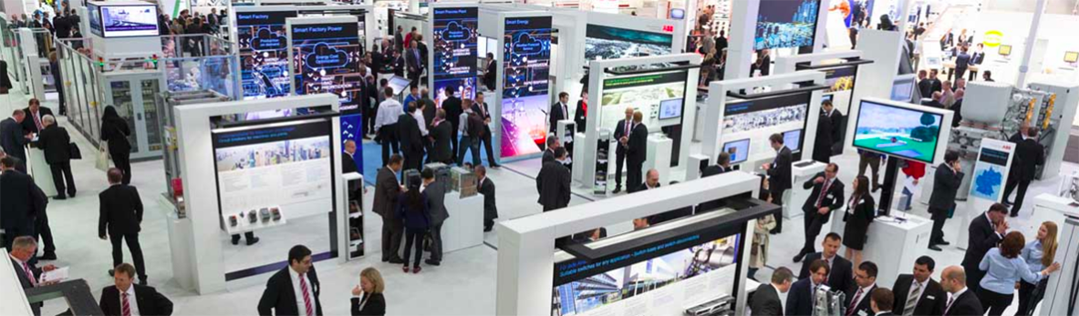
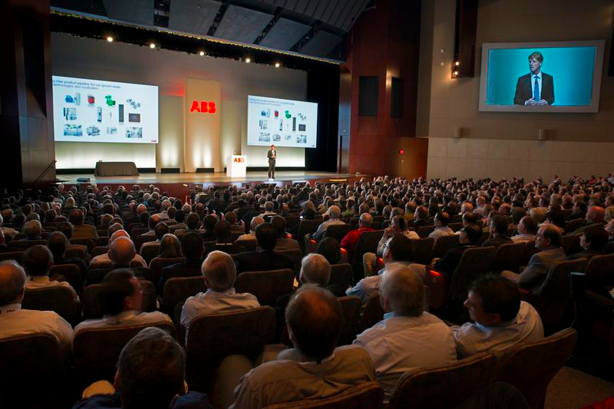
What this will mean for Houston 2017
It is still the same great event – we’ve always been about the customer
The sessions and content will remain the same
We still want customers, potential customers media, partners and passionate individuals to attend
We will be phasing in changes to the wider online content

Slide 5
How we are making the transition
Introduction
Implementation
Feb 1st
Mar 13th
Visibility of the new name ABB Customer World
The plan | Announce the name is changing and introduce ABB Customer World on Feb 1st ; reach out to different audiences explaining the change and update collateral through the month | Fully switch to ABB Customer World on day one of the event in Houston with updated collateral; keep some references to APW where needed, but phase this out after the event
We primarily refer to the event during this time as… | “APW” | “ABB Customer World 2017”
When communicating the name change or high possibility of confusion | “APW, now ABB Customer World, ….” | “ABB Customer World, formerly APW, …”
Or informally as… | “APW has a new name for 2017 - it is ABB Customer World” | “ABB Customer World is the new name for APW”
Avoid using … | “Automation & Power World” – just APW is best | “APW 2017” – don’t refer to the date “ACW” or “ABB ACW” – use the full name

Slide 6
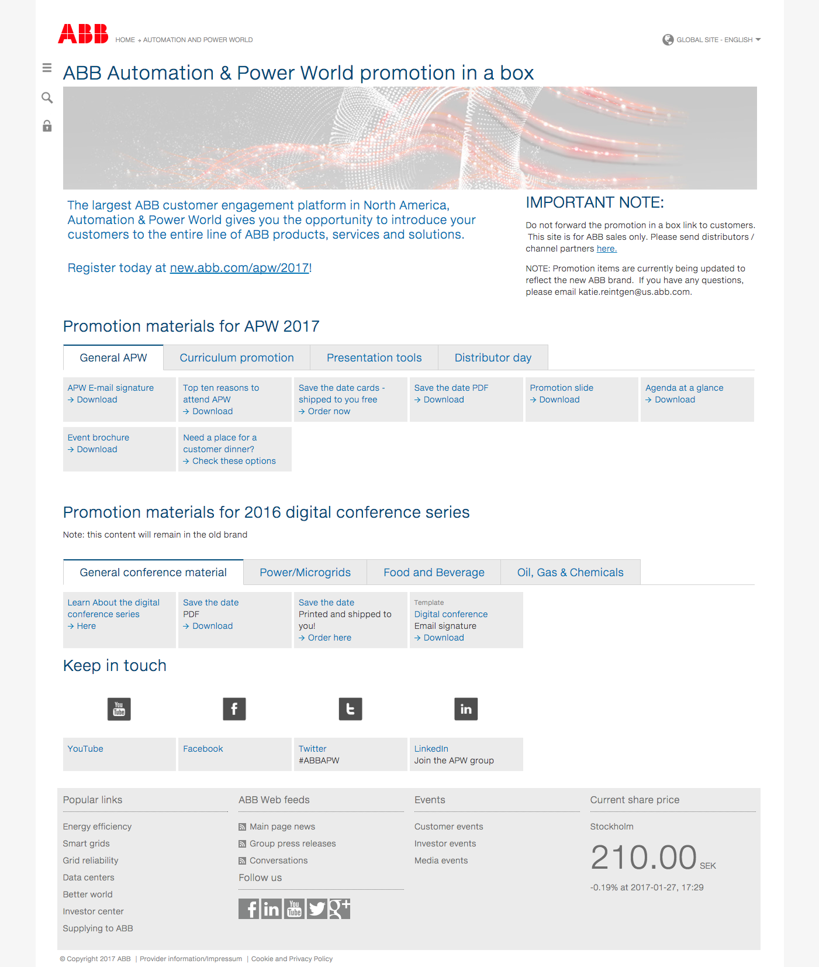
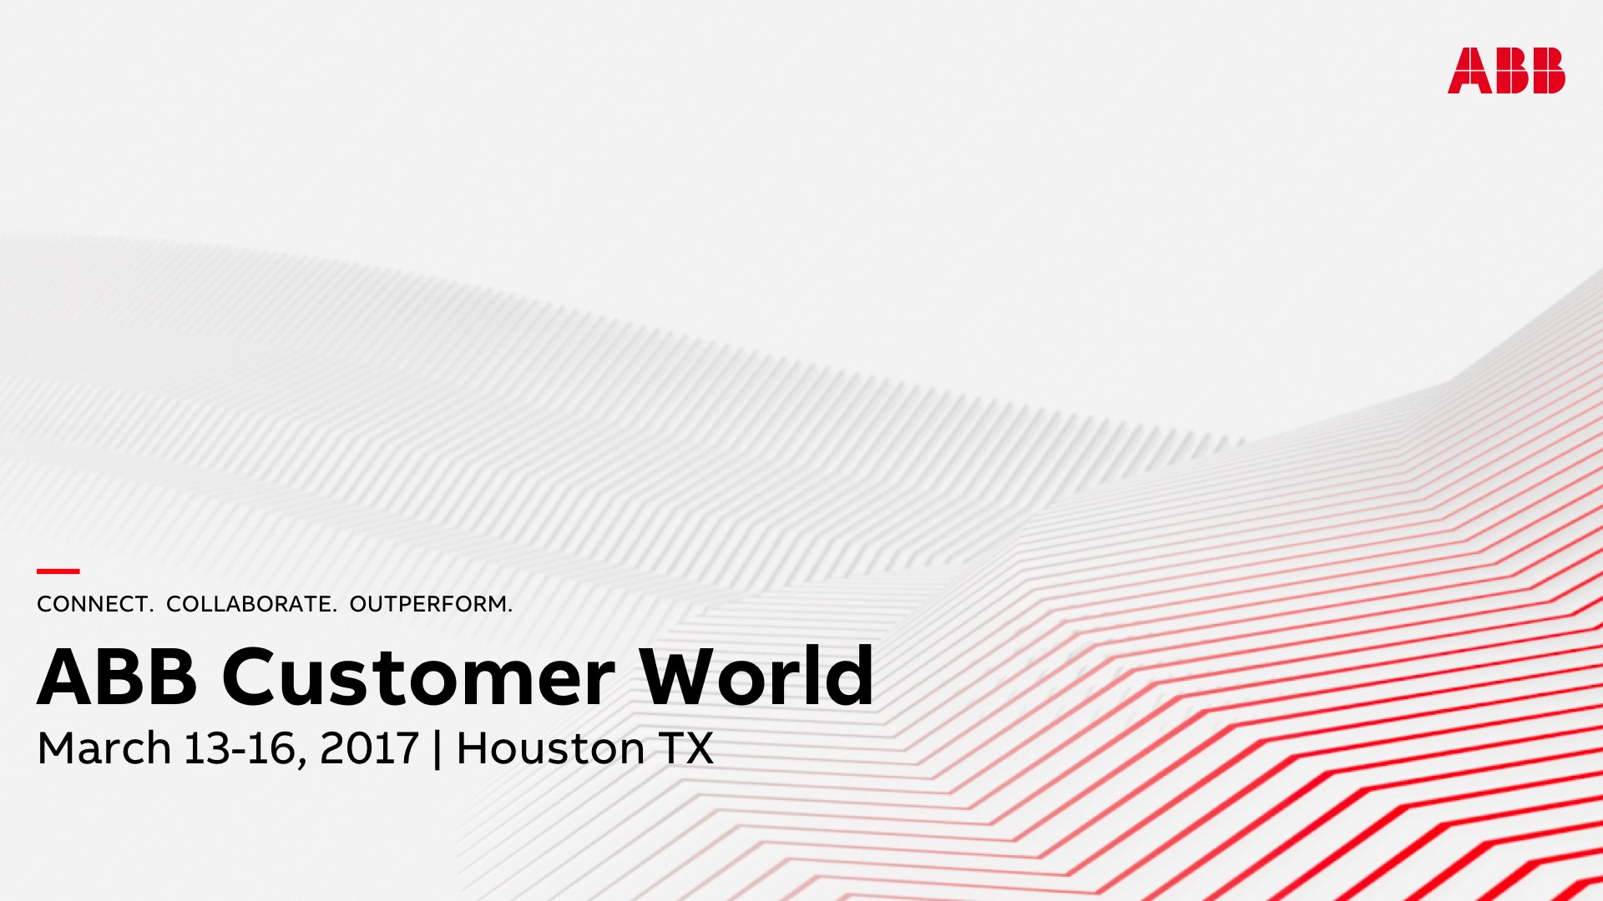
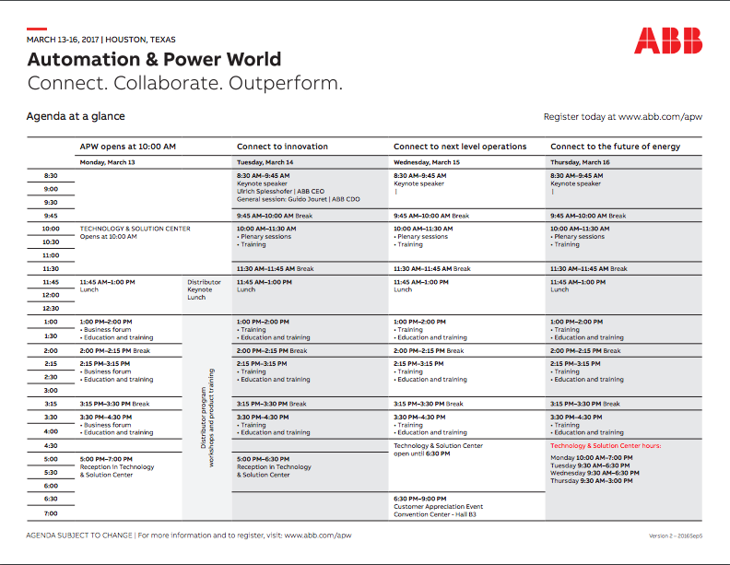
All you need will be available from “Promotion-in-a-box”
From 1st Feb, the information, guidance, messaging frameworks and collateral will be updated.
HERO | BELIEFS | BLUEPRINT NARRATIVE
KEY MESSAGES
PROOF POINTS
The Customer
This name change is an alignment that recognises that APW has always been about the customer
Customer-first thinking beats product-first thinking
Our success is driven by our customers’ success
Together, we drive progress
CONTEXT
ABB has a long history in power and automation but today we do much more than this, delivering increasing industrial digitalization in partnership with our customers.
APW has always been an event that focuses on the customer, creating dialogue, providing hands-on training and sharing their insights and needs.
CHALLENGE
The name ”Automation and Power World” cannot stretch any further and fails to represent what it (and ABB) offers today
SOLUTION
Starting this year, APW will be renamed as ABB Customer World.
OUTCOME
We will keep the same great networking and learning events but showcase more ways for customers to navigate the increasingly interconnected world and use industrial digital technology to outperform.
ABB is much more than power and automation
The APW customer is looking for more than P & A
ABB (and APW) has always been about the customer
More dialogue – understanding needs – hands-on learning
Together with customers we make progress happen
Long history of strong partnerships and collaboration
APW has always been a ‘customer’ event
Not just meeting ABB - networking with like-minded people
Active and engaged Customer and Distributor Advisory Boards

Slide 7
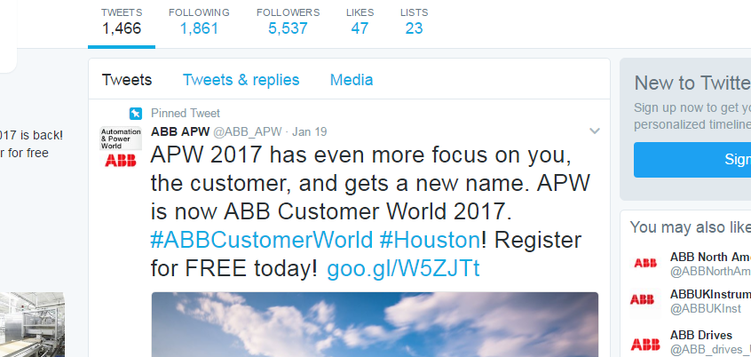
Example communication
Twitter announcement

Slide 8
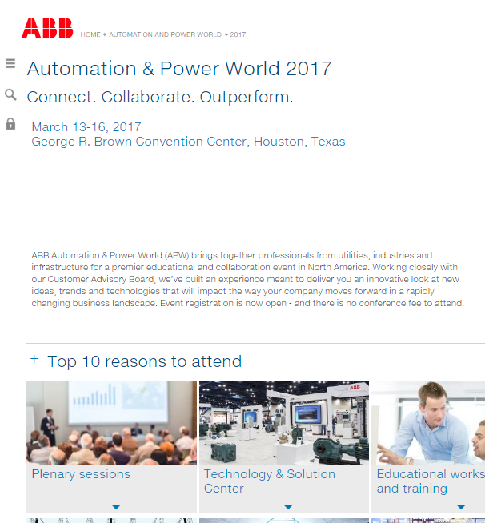
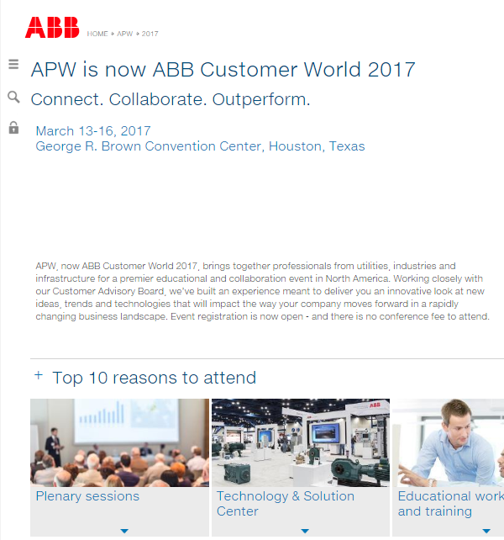
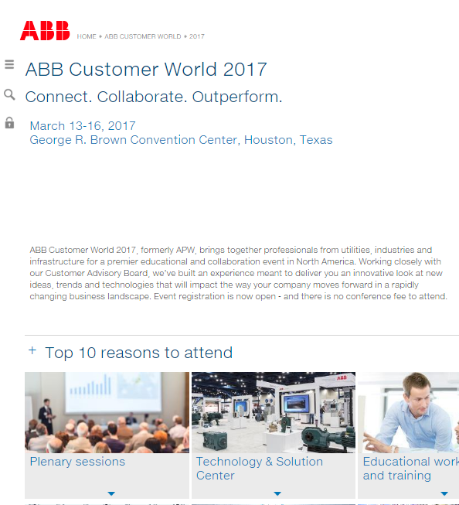
Example online change
2017 web page
Today
Pre-event
Houston

Slide 9
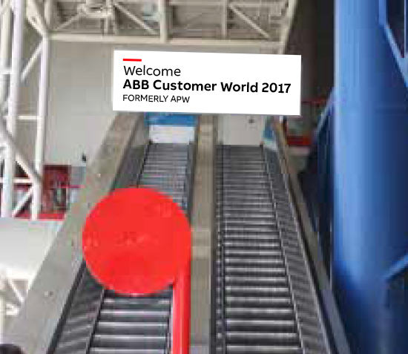
Where needed, a reference to APW may be included
For instance on signage where an attendee may still be looking for APW
Indicative visuals

Slide 10
Q&A
Potential questions | Answers
Will travel plans or hotel reservations need to change? | No. All our travel partners will update any travel bookings to reflect the new name of the event.
My customer’s interest is in Automation/Power. Should they still attend the event? | Definitely. The event will still feature the same great content it always has. The only thing changing is the name.
If the event itself isn't changing, why are you changing the name? | ABB has a long history of strong partnerships with our customers. We want to reflect this in the name of the event, so have decided to change the name to ABB Customer World.
Are there any other events affected? What about APW Mexico? | We're also holding ABB Customer World in New Zealand this year. Other ABB Customer World events will follow.
Does the new name mean the focus of the event will change? | At ABB, we make progress happen, together with our customers. So the focus of the event will continually evolve with our customers' needs.
We already have APW-branded content in the field. What happens to that? | We understand that it's not possible to recall or replace all content before Houston, so during the migration process APW- and ABB Customer World-branded content will co-exist. After Houston, we will update everything to ABB Customer World.
How do I explain this to my customers? They're going to be very confused. | We spoke to stakeholders both inside and outside ABB before deciding to make this change. The consensus was that the name of the event is irrelevant: it's the products, solutions and curriculum that are most important to them. You should explain that the event content hasn't changed at all: only the name has changed, to better reflect that the event has always been, and always will be, about them, the customer.
I sponsor the event. Will my sponsored content be updated to ABB Customer World for 2017? | Wherever possible, we will update sponsored content to reflect the new name before the event starts.

