Slide 1

Telx DCIM Journey
Telx enables an open, multi-vendor DCIM/DCSO platform for its entire data center portfolio.
Telx selects ABB Decathlon for Data Centers to gain visibility into its energy and power systems from a single screen.
Decathlon also will serve Telx as a business analytics tool for understanding profitability for its latest data center.
Notes:
Good morning! I’m Rafael Valdes with Telx… Thank you for joining us today. I’ve been looking forward to sharing my DCIM journey with you…
This presentation is about my personal experience in the research of a Systematic Data Exchange. Like a Tarantino movie, I’m telling you the end of the movie right now. My story will not have large amounts of blood or people getting killed… just few DCIM solutions……. I will tell you how I got there.
Before getting started, allow me just a few minutes to introduce you to Telx so that you can appreciate the context of my situation. Some of you may find that it’s similar to your own situation.

Slide 2
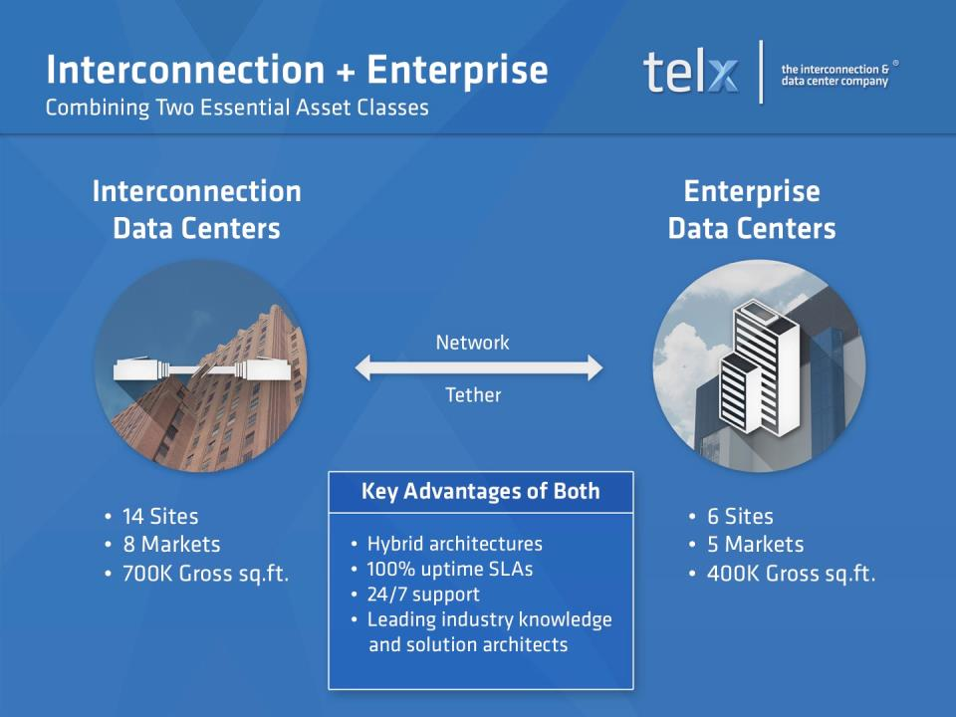
Notes:
Telx is a data center solution provider combining two essential asset classes: Interconnection and enterprise data centers. With industry-leading 100% uptime and 100% on-time service delivery SLAs, we help companies build more agile businesses faster with reduced infrastructure complexity and broader reach to new markets.
Later in my presentation, I’m going to introduce one of the key components of our data center approach that enables us to sustain our industry-leading performance.

Slide 3
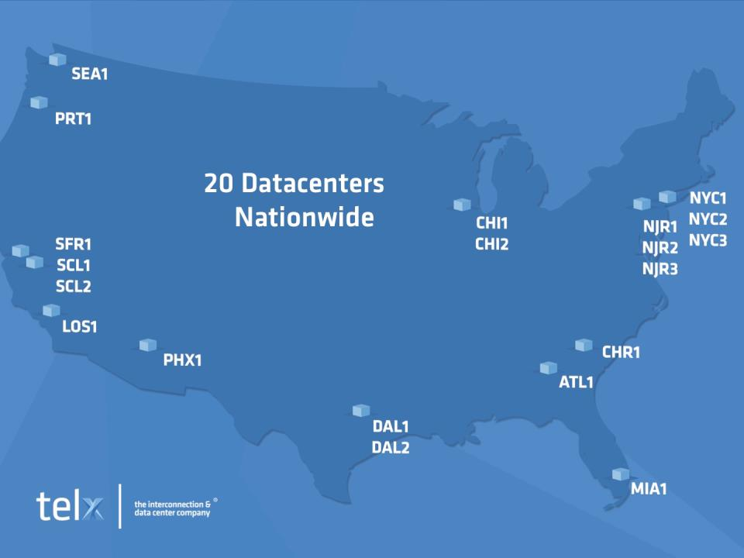
1.3M sqft | 50+ MW
White space | Critical power
Notes:
Our data center portfolio includes 20 data centers across America: 14 interconnection data centers and 6 enterprise data centers. Our data centers are located in the New York/New Jersey metro area, Charlotte, Atlanta, Miami, Chicago, Dallas, Phoenix, Los Angeles, Santa Clara, San Francisco, Portland and Seattle.
As a data center operator we have a unique component that distinguishes us from our peers in the industry—we manage and actively support about 50K connections among our customers. We are located in most of the large Metro Areas in the US, in buildings that serve as connectivity hubs.
We manage 1.3 million square feet of data center space, enabling the interconnection of more than 10 million square feet of data center space globally.
In my role as Head of Energy Management at Telx, my team is responsible for more than 50 MW of power capacity… We manage about 20M kWh of power usage per month, which translates to over $30M of total energy cost.

Slide 4
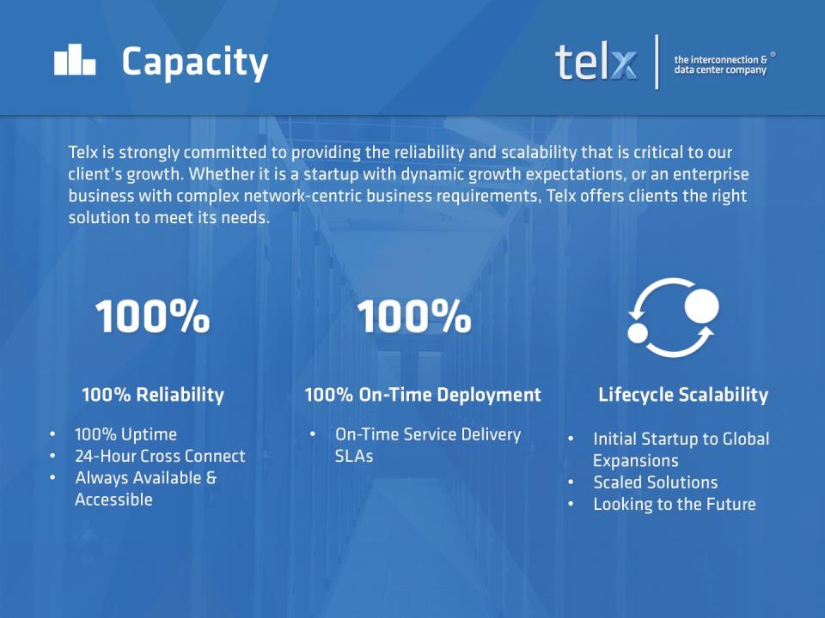
Notes:
And, my team is responsible for capacity, too… Telx is strongly committed to providing the reliability and scalability that is critical to our client’s growth. As I mentioned earlier, we need to maintain our industry-leading performance of 100% uptime and 100% on-time deployment. And because we work with over 1200 customers at various stages in their business life cycle, we must accurately forecast capacity needs. It’s imperative that we manage a flexible network of power, cooling and space so we can deliver services faster and in the most reliable, efficient and sustainable way possible.

Slide 5

Our Goals & Challenges
  Energy Management
Cost forecasting and containment
Capacity management
Business Analysis
Visibility to all 1200+ customers.
Trending capability for space, power, cooling, connectivity and added services
Context
Our data centers are a blend of owned and leased infrastructure
Infrastructure across 20 sites and 60+ suites or floors
My journey to find a “real DCIM” system
Notes:
Our goals & challenges were simple: We needed a solution to help us better manage energy cost forecasting and cost containment, specifically as it applied to energy and capacity management. From a business angle, we needed to enable ourselves with a better understanding our customers’ usage trends, and we wanted to know more details about how our revenue is broken down. We wanted to do this in a similar way to how Google and Amazon track usage patterns on the web.
Context: Telx has been in the colocation services business since the early 2000s. Since 2006 we have been actively growing our presence, for example: we grew from 2 sites to 14 sites by 2011. Then we grew our presence from 14 sites to 20 sites by 2014. We continue to grow and expand our presence—more coming next year!
To enable our business to grow this much, we have a blend of owned and leased infrastructure. By that, I mean that we furnished and installed generators, UPSs, cooling systems, etc. And, in some cases we acquired suites or floors with infrastructure already installed, and/or we became a tenant of the white space in a turn key data center, like Digital Realty, Sabey, Vantage, etc.
What seems simple in theory can be deceptively challenging to carry out in practice… This is my story.

Slide 6
My Journey
Research and vetting of DCIM solutions
Conclusion: ‘Best in Class’ applications will be selected
Cost forecasting and containment initiative
Fulfill BMS across Telx portfolio
Implemented several industrial-grade DCIM/DCSO
2008 2009 2010 2011 2012 2013 2014 2015
Green IT solutions gain market momentum as
Telx formalizes BCM
DCIM emerges as a formal solution
Challenges for “right” BMS continues
Industrial controls exposure
Architecting for business analysis
Notes:
Earlier in my career, I was a Facility Manager dealing with the day-to-day operations of facilities.
<click> In Q3 of 2008, I accepted the role of Energy Manager. The position was created in response to Telx’s need for more formal forecasting and cost containment for both energy and capacity. Telx was growing and had plans to continue growing at a rate of about 30% year over year. A the same time, energy costs were rising at an alarming rate in some regions. This was at the time of the credit crisis. Commodities, including energy, were at historic highs. Keep in mind, during this time there was no formal solution for DCIM.
<click> In 2009, intelligent monitoring and green IT point solutions gained momentum in the market. But, still no DCIM. We needed to know more about our customers electric consumption. BCM is now part of all new deployments and we started with BCM hardware retrofits and the RPP to gain usage visibility.
<click> In 2010, I was tasked with filling in the gap for BMS across Telx’s portfolio. In reality, this task is a data collection gap… Still, there was no formal concept of a DCIM system… Telx’s portfolio has a large set of legacy infrastructure in hands of our landlords… A few months of research uncovered very little options with respect to an integrated energy management platform specific to data centers. However, as our business grew, so did our need for cost containment. We had to invest in a BMS, even though we were aware of its limitations… We needed to start collecting data. Therefore, I decided to implement BMS and BCM in separate platforms. Why? Due to cost and implementation timelines.
<click> Around 2011, DCIM emerged as a formal solution. It looked promising so I began looking into it. I discovered most vendors were not meeting our needs and the tools looked immature. To me, this meant that they could not extract/integrate different data types or non-native applications, like financial tools and customer tools… Meanwhile, Telx continued to grow.
<click> In 2012, my CEO asked us to look into DCIM and explain what was our plan for it. We began formally researching and vetting DCIM solutions. We realized we had been doing DCIM already at Telx by using our branch circuit monitoring data and comparing it to data in our financial tools and other reports that had nothing to do with power; for example, customers, connectivity and space analysis reports.
As a result of this research and analysis, my IT team and my Energy team concluded that we will be using ‘Best in Class’ tools that can be part of the Telx Open System. NOW looking back in time, this was a milestone and a key to the future. Later in my presentation, I’ll show and explain in more detail the concept and approach.
<click> In early 2013, the challenge to upgrade, that is, to allow data exchange in our existing BMS coverage continues. I know the ultimate goal, but I still don’t know how to get there with a consistent and systematic implementation approach. Coincidentally, I began working on another data center project (yes another expansion #18) where I got to see for myself the benefits of the industrial control architecture versus the traditional non-industrial tool, which is typically a black box or a self-contained solution. I implemented my first industrial-grade system in Q2 of 2013… The Black box I refer to is a stand-alone tool, which can do a great job and can be integrated, but typically data exchange comes at a great expense of time and money, because wasn’t designed to do it.
Here it was, in front of my eyes. The industrial sector had overcome similar and bigger obstacles for decades. I realized that I can adapt the architecture so I can use the standards in industrial controls and use off shelf applications that can share data natively. I would need to develop an architecture to address Telx’s DCIM and business requirements for existing BMS deployments and new data center builds. By First half of 2013, based on what I learned about different industrial tools and architectures, I was introduced to Decathlon for Data Centers among others.
<click> In 2014, One more expansion, #20, it needed to be implemented now in NYC. We selected a new vendor ABB Decathlon for Data Centers, we favored their industrial controls and its architecture for easy integration over traditional BMS for capabilities with electrical and cooling systems.
As we approach 2015, my journey continues..… Does my journey and suffering sound familiar to some of you?

Slide 7

Recap of the Challenges
Our business initiatives and goals:
Holistic data view of the business across multiple departments: Finance, Sales, Product/Marketing, Engineering and Operations.
Challenges encountered:
Vendors focus on a narrow solution instead of delivering a “true DCIM” product.
Most vendors hold the data hostage—my own business data!
Data integration is not native in most solutions.
Telx continues to grow—so the magnitude of the challenge increases over time.
Hercules of the data center battles the DCIM Hydra
Notes:
Here’s a recap of the multi-faceted challenge that we’ve had to overcome until the middle of 2013.
Keep in mind, the business objective we were tasked to meet is forecasting and cost containment applied to energy management in our data center. I needed to provide key data to executives in multiple teams: Finance, Marketing/Product, Sales, Operations and Engineering.
The photo shows how I feel sometimes when searching for a “real DCIM” system. One challenge—find a real DCIM system—has had so many obstacles.
This discipline is referred to as data center infrastructure management. In search for a viable DCIM platform, we encountered many obstacles. <Read bullets.>
Challenges encountered:
Vendors focus on a Narrow Solution instead of delivering a “True DCIM” Product
Most of the Vendors Solutions keep Data as a Hostage, my own Business Data. They collect and store the data with limited configuration options. This is natural, the application will only configure what it was designed or coded for.
Data Integration is not native in the Solutions Found. Therefore data integration is a customized solution, fragile and non scalable.
Telx continues to grow—so the magnitude of the challenge increases over time! I’m having a hard time keeping up, Telx is growing at about 30+ every year. By adding suites and new sites.
The rest of my presentation will focus on how we overcame this challenge.
-----
I realized we needed to engineer an end-to-end solution. We needed a real framework on a singular architecture that will give us what we need. After researching the new tools in the DCIM arena all of them had a common denominator, they were the holder and guardian of the data.

Slide 8
Telx DCIM Vision in 2012
Users
Operations
Engineering
Sales & Marketing
Finance
Customers
Data Storage
Telx Data Warehouse
Key business metric reports
Dynamic, scalable and real-time reporting
Best-in-Class apps
Asset mgmt, space, power and connectivity Inventory
BCM: real-time data
from customers’ IT Load
Finance
and accounting
systems
Customer portal,
new sales orders , and
ticketing systems
BMS,
Monitoring, controls,
cooling and electrical systems
Utility power invoices,
tracking platform
Data Source
Notes:
At Telx “we have a dream”…. I know the end goal, but I still don’t know how to really get there based on the tools that I have seen so far during my research of the DCIM Market in 2012.
Knowing the requirements from Finance, Marketing and Product teams… now the IT team (they manage a series of financial and CRM tools)… and Engineering, I came to a conclusion and a vision of how we would like to have our Ecosystem configured.
This diagram represents our conclusion in 2012 and the starting point for next two years in my journey—2013 and 2014.

Slide 9

Critical to Success
Combine and streamline business and I&O objectives.
Design and create a DCIM/DCSO system for a holistic view of our business.
For Telx, the solution must be vendor-agnostic: a platform with a truly open architecture.
Finding the right fit
Notes:
We focused on 3 critical objectives:
Success criteria number 1: We wanted to integrate and streamline a solution to address business objectives, not just IT objectives, because our executive team needs insight to our operations so they can better allocate capital to our sites—our data center portfolio. We needed a way of sharing our performance data so we could all work together toward realistic goals. That means sales teams, operations, and marketing teams…
For example: As it was, our team had to run around to collect data manually—from electric meters and RPP/branch circuits, to the outlet that supplies the power strips to the racks. Then, we dumped everything into spreadsheets so we could see trends and use this to analyze and forecast our energy requirements. But none of this was integrated, so our data became unwieldy and prone to errors. To illustrate, I had to consolidate dozens of energy bills every month. Not just one power bill for each data center—some sites have multiple power bills depending on the site configuration! It’s exceedingly time-consuming and tedious. It took valuable time away from the actual analysis and forecasting… Trust me, I had a very strong personal incentive to move away from manual data collection and juggling spreadsheets.
Success criteria number 2: We wanted to integrate the BMS with the DCIM system (and not the other way around), because despite claims, a BMS is not really integratable. Sure, you can integrate anything if you have a lot of time and a lot of money for custom services. But, practically speaking, a BMS can’t handle non-native applications. It is not truly an open platform from which we can achieve data center service optimization—also known as DCSO.
For example: Some vendors suggested that by exporting data into a spreadsheet—that was an “integration solution”. Can you imagine exporting data to and from financial planning applications or energy management applications? This didn’t fit my definition of integration…For the reasons I mentioned earlier, exporting data from different sources at different times leads to inconsistent and inaccurate data. And, once you export the data, it’s just a snapshot of a given time-period. It’s not real-time, which can impact some decision-making.
Success criteria number 3: AT telx we wanted a DCIM architecture with a truly open architecture for multiple reasons:
We know there isn’t a single solution for all.
Because it helps us be more nimble—more agile—in delivering services to our clients.
For example: Instead of relying on one vendor, we can work with many vendors. This opens up our options. If one vendor is resource constrained, then we can use another. If one vendor is too costly, then we can use another. If one vendor doesn’t have the capabilities we seek, then we can use another. An open platform helps us compete in the market place while reducing the risk of being tied to any one vendor to meet our very important SLAs with our clients.
We stayed focused on these 3 success criteria to help us find the right fit for our needs.
Using engineering and construction lingo, the engineering document I needed had to have an open architecture and combine business and I&O objectives as part of the basis of design.

Slide 10
How I got there?
Success Criteria
Steps Taken
Combine and streamline business and I&O objectives.
Design and create a DCIM/DCSO system for a holistic view of our business.
For Telx, the solution must be vendor-agnostic: a platform with a truly open architecture.
Worked together with the Executive Leadership Team to determine performance indicators.
Found and adapted a model to meet both business and engineering requirements.
Looked outside traditional offerings to include industrial solutions.
Determined the right combination of functionality and cost: “Combo Meal”
Architected a Layered Unified Platform (LUP): the “right DCIM” for Telx
Expanded the number of vendors to give Telx a competitive edge.
Notes:
<click> To meet success criteria #1, I gathered requirements so that I could create a reference document that captured our engineering and operations objectives, as well as our business and financial objectives. I worked closely with my Finance colleagues. And, I also worked together and received support from our CEO, CFO and the EVP of Engineering. Having top-down support was imperative for the successful adoption of the solution.
<click> To meet success criteria #2, I worked with a third party to create a technical blueprint that addressed our business and engineering requirements, so that we could find a system (the tools) that would enable us to deliver cost-effective solutions for each profit center, that is, each data center site. The key was finding the right combination of functionality and cost—just like selecting a combo meal: How hungry are you and how much are you willing to spend? From this blue print we developed a system architecture I call a Layered Unified Platform or “LUP”. In essence, it’s a true DCIM system and one that’s right for Telx. We’ll take a look at the LUP diagram on the next slide.
<click> To meet success criteria #3, I got lucky. In the summer of 2013, Telx announced its third expansion in New York City, the NYC3 facility. The facility was a landmark building where BMS controls were needed. At this time, I was introduced to Decathlon for Data Centers. As I mentioned earlier in 2013 I had exposure to industrial systems, I began learning about the architecture for industrial controls. Industrial systems can process huge amounts of data in real-time. And, this data is made visible at the executive level and at other business functions of the company—such as, production lines. To illustrate, Decathlon for Data Centers is already integrated with non-native applications, like SAP, and it’s used in mission critical facilities, like power plants. Upon further investigation, and with the years of research that led up to this point, I proposed that an industrial-grade DCIM was a good fit for Telx.

Slide 11
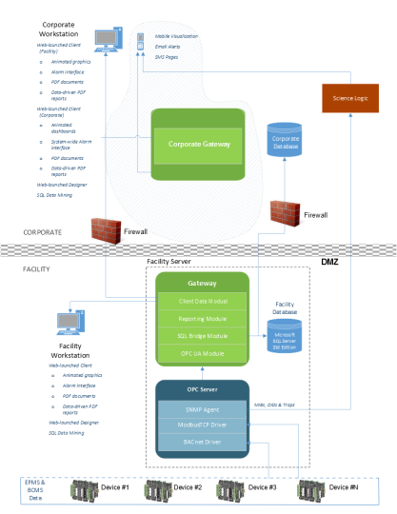
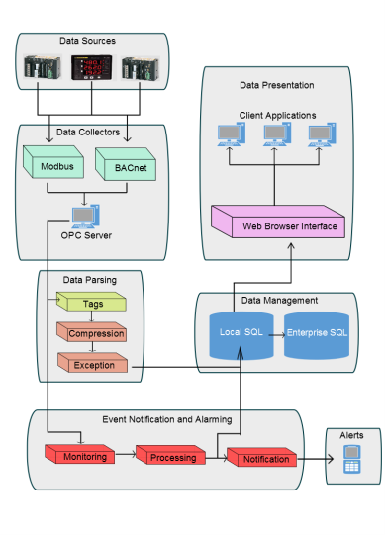
Layered Unified Platform (LUP)
vs. Industrial Controls System
Layered Unified Platform
Industrial Controls System
Notes:
As I mentioned earlier:
Basic concepts of LUP, as well as the components. I’ll explain why it’s called “layered.”
Layered: clearly defined functions
Data sources – Provides data in all flavors/protocols, such as Modbus, BACnet, SNMP, Lonworks, etc.
Data collection layer – Makes the data now independent for their protocol source. It has an standard as an output, in this case, OPC.
Data management – For me this is one of the key features. Data can now be separated from the visualization and the data collection.
Similar to Telx’s vision in 2012. In the Industrial Controls, it’s a whole separate component that can SERVE data to other layers and/or applications.
Unified – With the data collection layered, I can collect probably any protocol out there including IT and have the data normalized for reporting. I don’t need to have multiple platforms to collect data and have to integrate later upstream.
I want to make clear that I didn't re-invent the wheel, but I wanted to bring industrial standards to data centers. Basically, I adopted the industrial standards and technical requirements for Telx’s needs.

Slide 12
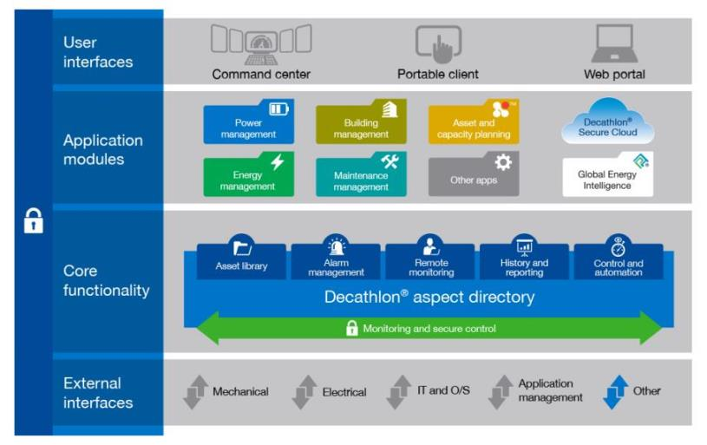
ABB Decathlon® for Data Centers
Non-native apps (DCSO)
Notes:
You can see the similarities. This diagram illustrates the Decathlon for Data Centers system. It identifies the major components of Decathlon, including its platform which delivers the core functionality.
The Decathlon system is built on an open platform supporting secure, bi-directional communications with mechanical, electrical and IT systems. Data is routed through the system in real-time to application modules that provide the visibility, decision support and controls for advanced capabilities, like energy management and capacity planning.
With Decathlon for Data Centers, you don’t need to license the entire system. <click> For example, Telx added only those components of the solution it needed—which you can see here, highlighted in yellow.
This diagram shows how end-users interface with the software application… to access the applications… that are made available through the platform… which:
monitors and measures any data accessible via external interfaces;
normalizes and analyzes that data;
advises the end-user via a wide variety of decision support dashboards and reports; and
automates both workflow and systems to mitigate risk of human error and ensure optimal utilization of all data center assets.
In other words, Decathlon can communicate with any standard or proprietary communications protocol to monitor data center assets—whether it’s mechanical or electrical equipment…or if it’s an IT asset, then it can monitor the device, the O/S, and application…and it can monitor environmental and physical data, such as temperature and vibration… For example, if you have a BMS which monitors your data center’s ambient temperature and humidity, then Decathlon collects that data, normalizes it, and includes it in the analyses of a more comprehensive data set. The advantage is you can now see the facility data with the IT data. Or even business data with data center performance data. The information shared from a single data set minimizes calculation errors and provides a single, real-time operational environment of your data center.

Slide 13
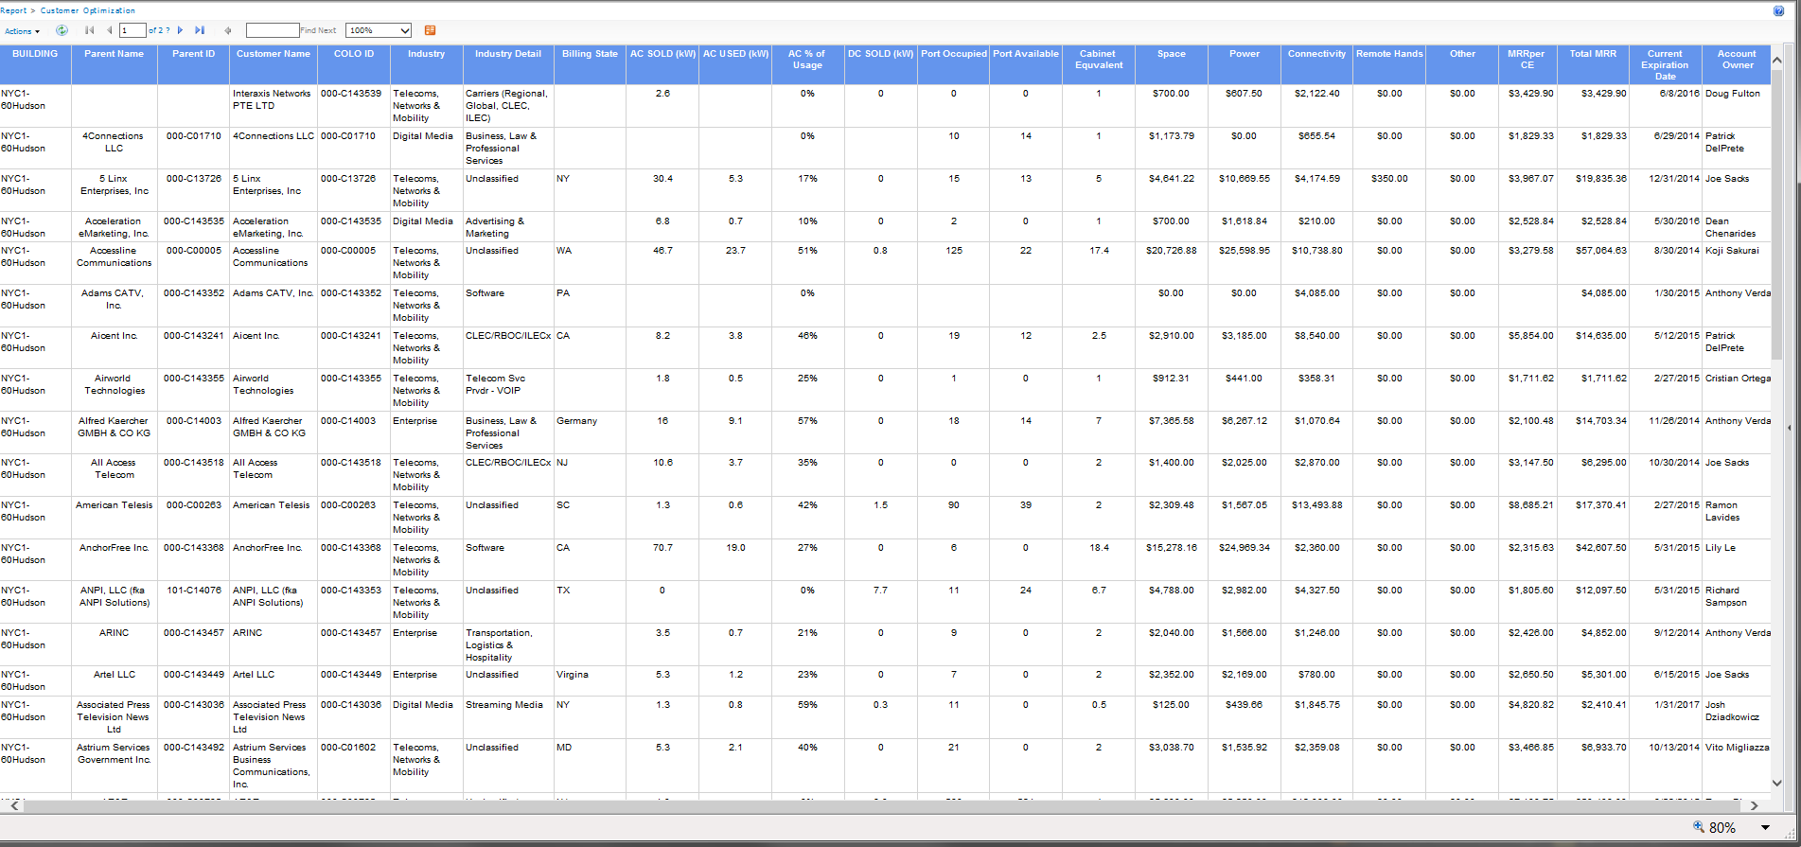
Example 1
Customer Optimization Report
Notes:
Here’s an example of our optimization report. I realize you can not see the details on this report—that’s OK. The key points are:
The data on this slide comes from multiple source and can be represented graphically or in the form of a table. In this example#1, our optimization report is used by different groups in the corporate office. The finance team uses it to analyze profit, the sales team uses it to adjust pricing when its time for contract renewal, the product and marketing teams use it to better understand how the products and services are sold to and used by customers… Before our vision in 2012, we had to wait longer to make the data available. In some cases, we couldn’t access the data at all.
Area in red, comes from our finance software platform that tracks our customers’ entities and information.
Area in green is data coming from the branch circuits hardware and power usage for each of our customers.
Area in yellow comes from our engineering asset management for provisioning of space, power and connectivity.
Decathlon for Data Centers can provide some or many of this data and functionality. The point is, it can work with non-native applications and you have the option to use as little or as much of Decathlon as you need. It helped us achieve our vision.

Slide 14
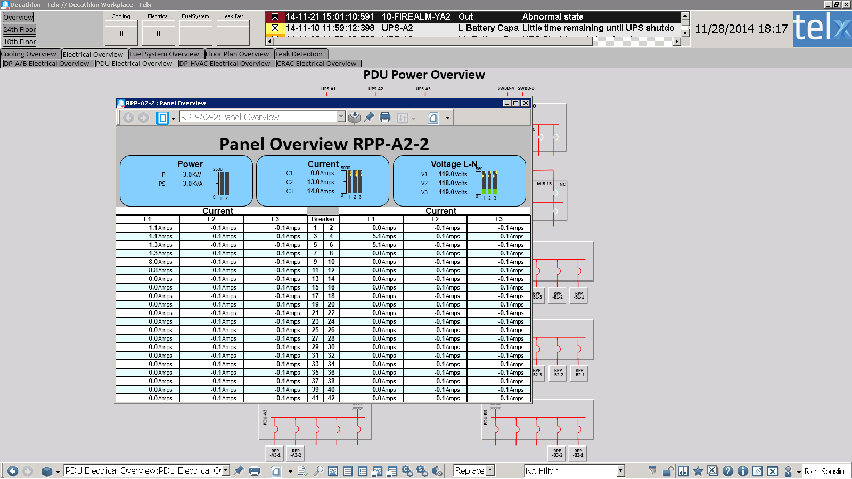
Example 2
RPP Branch Circuit Data
Notes:
Here is a sample dashboard/report that’s used by Operations to ensure the main breaker and the branches don’t overload. The data on this screen get shared with the Telx Warehouse for business reports.

Slide 15
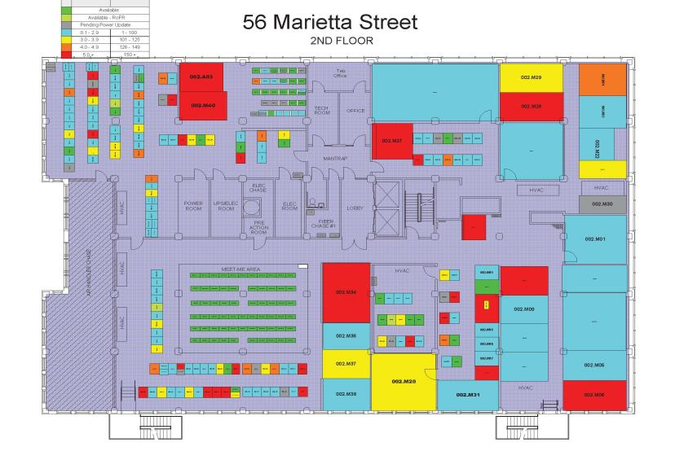
Example 3
Sold SQ-FT Density Interactive
Notes:
Our space provisioning tools allow us to see where we have space available to sell. This is used by sales engineers during pre-sales process and then by the engineering and operations teams for a new installation. The data supporting this graphic gets shared with Telx Data Warehouse as space sold by customers.

Slide 16
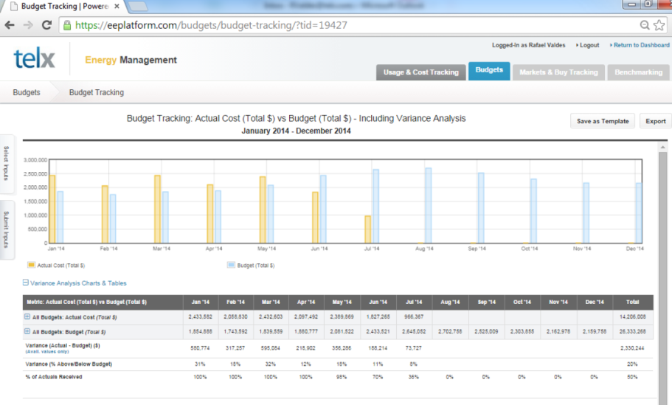
Example 4
Electric Usage: Actual Total Cost vs. Budget
Notes:
This is a cloud application. This application stores, trends and forecasts utility power usage for all Telx sites and suites. Data for kwh usage, total cost and unity cost $/kwh is scheduled to start exchanging data into Telx Data Warehouse via web services this December.

Slide 17
Summary of my Journey:
The Big Picture
Recognize the pain points; identify the gaps, e.g.:
  Data collection
  Data analysis
  Business analysis
Work with ELT, finance, other business units and I&O, because executive buy-in will assure adoption and long-term success.
Develop a business case; understand the implementation will take more than a year.
Develop a phased plan in alignment within your company’s working capital and appetite for change and priorities.
Select partners whose IT strategy and integration vision are aligned with yours.

Slide 18


Lessons Learned:
Telx DCIM Journey
Don’t get a BMS/design that will constrain your business operations, analysis and growth.
Reduce vendor dependencies by enabling an open architecture so that you can work on multiple projects simultaneously, as well as avoid vendor lock-in.
The effort to identify your DCIM/DCSO requirements involve really understanding both I&O and business needs, capabilities and limitations, so that you can address your data center operations and business as a whole.
Work with your IT team. Include (or borrow) a data architect on your team—not just traditional MEP engineers. Today the traditional MEP should be renamed to MEP-D; D is for data.
There is no need to replace legacy BMS implementations. Legacy systems can be added to the DCIM/DCSO platform. It requires some work but it can be done.
Today
Yesterday
Notes:
In conclusion, I would like to leave you with 5 quick lessons from my long and painful journey: <read slide>
Don’t get a BMS that will constrain your business operations, analysis and growth. It can quickly turn into a mess.
Reduce vendor dependencies by enabling an open architecture so that you can work on multiple projects simultaneously, as well as avoid vendor lock-in and bring more competition to your bidding process.
It’s an internal multi-team effort. You probably will have to involve IT, finance, accounting, product and marketing teams to define goals and priorities.
Data engineering or data architecture has to be part of the equation.
By understanding the different layers of the industrial controls systems, you will find solutions to incorporate stand-alone BMS systems. It will take some work and you may need to add some off-the-shelf applications, but you don’t have to replace it until it is necessary.

Slide 19
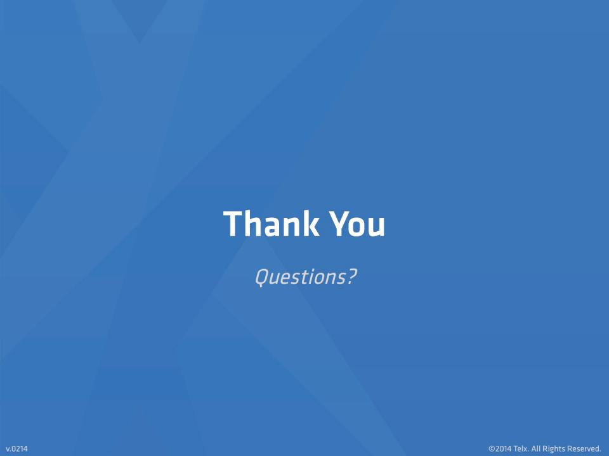
Notes:
Thank you for your attention. Rich and I are happy to address any questions you might have.

Slide 20
Appendix

Slide 21
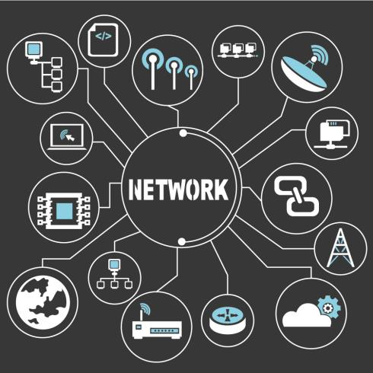
Telx Ecosystem for DCIM/DCSO
Your DCIM/DCSO platform must be vendor-agnostic: a truly open architecture.
Can your DCIM platform capture and normalize all of your communication protocols? For example:
IT systems – SNMP, IPMI, ILOM
MEP systems – Modbus, BACnet, Lonworks, etc.
Analog systems
Data conversions – kW to kWh, BTU or MWh
Increments - minutes to seconds.
Third party data outside your network, e.g., cloud application
Data Center Automation
Telx customer web portal
SAP
Telx DCIM/DCSO System
Salesforce
Cloud Application
Power Billing System
Aperture
Telx Data Network

Slide 22
Implementation
Integration Component

Slide 23
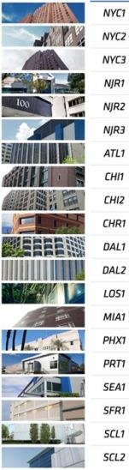
Results and Next Steps
Next Steps: Complete Visibility
We now are in a position to have:
Real-time monitoring and decision support of our data center operations accessible to all of our business units so that we can analyze and make informed decisions faster, e.g., profit analysis.
An open and scalable DCIM/DCSO platform to integrate systems faster, e.g., a business acquisition that may already have a BMS in place .
Reduced vendor dependencies so we can deliver data center expansions faster to get work done simultaneously.

Slide 24
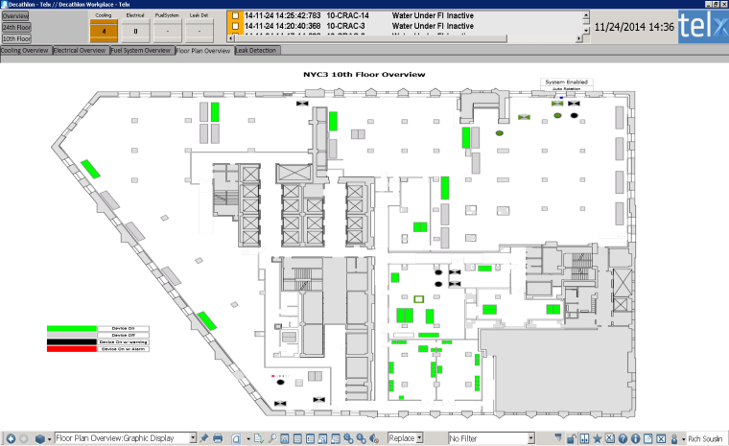
Example 2
Dashboard

Slide 25
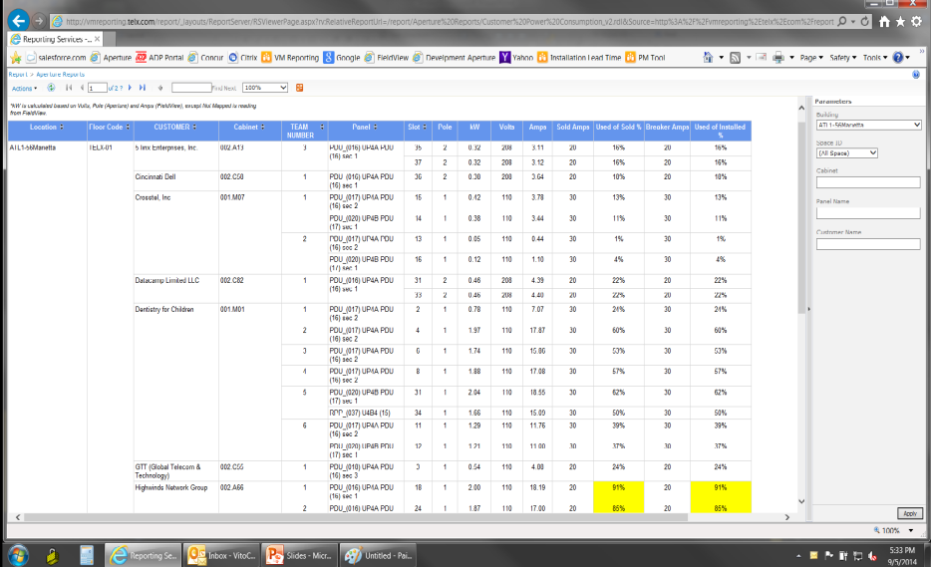
Example 5
Customer Power Utilization

