Slide 1
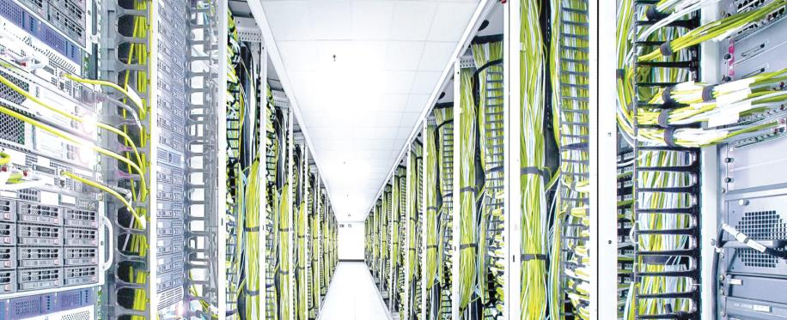
Prepared for Utility Analytics – The Big Data Revolution by Marina Thiry, January 14, 2015
Integrating Data Center Performance Metrics into Your Business Strategy
Notes:
Conference: Utility Analytics: The Big Data Revolution
Date: January 13 – 15, 2015
Location: San Diego, CA
Session Abstract: Amid the Big Data din of 2014, a profound change in today’s energy-driven market place quietly emerged: Enterprises have begun integrating their ‘back office’ data center performance metrics—including energy consumption—into their ‘front office’ bottom line business strategies. This session does not solely focus on sustainability or efficiency initiatives. Instead, this session introduces how forward thinking enterprises are now using their data center performance metrics to analyze profit, adjust pricing, and to better understand how products and services are sold to and used by customers.

Slide 2
Agenda
1. Introduction
    ABB – From industrial automation to data centers
2. Why focus on data center energy consumption
    Evolution of data centers
3. What is DCIM and why it matters to utilities and enterprise
    DCIM definition and models
    Data center automation
    Data center landscape
    Data center [3 Cs]
4. How ABB’s DCIM customers use big data and utility analytics
    Goals and challenge
    Approach – critical to success
    How they use our DCIM solution
    Results - examples
    Data center operations and business KPIs
5. Call to action
    What you can do now

Slide 3
introduction
ABB Decathlon® for Data Centers

Slide 4

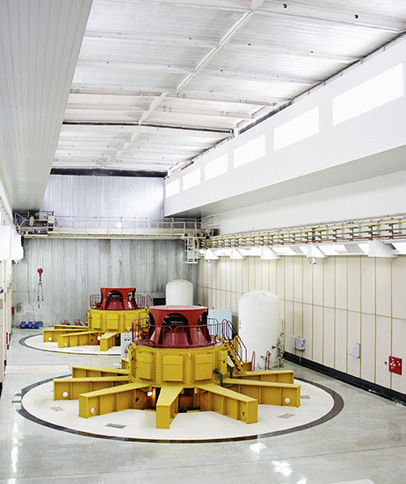
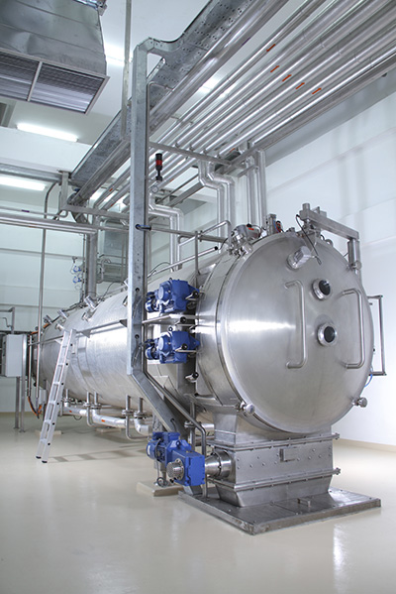
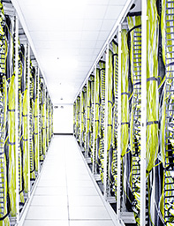





Introduction
ABB: Who we are and how we help
ABB is a global leader in power and automation technologies that enable utility, industrial and enterprise customers to
improve performance while lowering environmental impact.
Notes:
ABB is a global leader in power and automation technologies. We’ve built our reputation on successfully helping utility, industrial and other enterprise customers improve the performance of their mission critical systems and facilities. We continue to innovate, as well as acquire excellent data center technologies, products and services—like the ones listed on this slide.
In today’s presentation you’ll find a recurring theme inherent in our power and automation history that has defined our approach with data centers today. That is, we help you manage the 3 Cs: cost, capacity and control.

Slide 5
Introduction
ABB: How we fit in and stand out
We’re proven.
We’re committed.
We innovate.
We’re Proven. In 2014 ABB earned $40 billion in revenue with 140,000 employees in about 100 countries.
We’re Committed. ABB was formed in 1988 through a merger of the Swedish company ASEA and the Swiss company Bovari Brown and has a rich history in power and automation technologies going back to the 1880s!
We continue to innovate. ABB has 5 lines of business: Power Products, Power Systems, Discrete Automation and Motion, Low Voltage Products, and Process Automation—all of which bring innovation to all kinds of critical facilities.
Notes:
By way of introduction, here are 3 data points to help us get acquainted:
We’re proven. Unlike many businesses in the DCIM market, ABB has a long-standing history with building profitable lines of business. Last year (2014) ABB earned $40 billion in revenue with 140,000 employees in about 100 countries.
We’re committed. ABB is a publicly owned company with headquarters in Switzerland. We have a rich history in power and automation technologies. ABB was formed in 1988 through a merger of the Swedish company ASEA and the Swiss company Bovari Brown, which were founded in 1883 and 1891, respectively. So, our European founders have been inventing power and automation solutions and taking them to market during the same time period as Thomas Edison!
We continue to innovate. ABB has 5 lines of business: Power Products, Power Systems, Discrete Automation and Motion, Low Voltage Products, and Process Automation. The Process Automation line of business—home of Decathlon for Data Centers—provides solutions for instrumentation, automation and optimization of industrial processes. We are now bringing these innovations and exacting standards that service industrial critical facilities (such as power, oil & gas, chemicals and pharmaceuticals) to the data center.

Slide 6
Why focus on data center energy consumption
ABB Decathlon® for Data Centers

Slide 7

Internet of Everything (IOE) fuels data center growth
Cisco’s 2014 Global Cloud Index forecasts:
Data center traffic will nearly triple on the back of cloud growth in the next five years to 8.6 zettabytes annually by 2018.
Traffic will grow with a CAGR of 23 percent. The number counts traffic from data center to user and data center to data center.
Notes:
The “Internet of Things” has evolved to the “Internet of Everything.” According to Cisco’s 2014 Global Cloud Index:
Read bullet 1
Read bullet 2
Worldwide we’re experiencing phenomenal growth in data center traffic, which means data centers are consuming a vast amount of electricity to keep the data traffic flowing…

Slide 8
Electricity consumption is a key indicator of
data center market size and growth
Europe
3,318 TWh
North America
4,661 TWh
Asia & Oceana
7,838 TWh
Central & South America
978 TWh
Notes:
Definition: Terawatt hour (TWh): one trillion watt hours.
Source: US Energy Information Administration http://www.eia.gov/countries/country-data.cfm?fips=US&trk=m
This slide gives you a regional perspective of market size and growth. You can see that Asia & Oceana are the largest consumers and you can make some general assumptions on population size and the electrical infrastructure that supports them. But, to understand what this means for the data center market, you need to dive deeper—at the country level.

Slide 9
Electricity consumption is a key indicator of
data center market size and growth
Rank | Country | TWh Consumed | Avg Watts per Person*
1 | China | 4,468 | 447
2 | United States | 3,833 | 1,683
3 | India | 865 | 90
4 | Russia | 889 | 808
5 | Japan | 921 | 774
-- | World | 19,397 | 313
Table data from the U.S. Energy Information Administration: www.eia.gov
*Approximate only. The average Watts per capita is based on information from 2002-2010.
Notes:
This table shows the top five countries that are the biggest consumers of electricity. As mentioned in the previous slide, dependencies on data centers are growing—big data, mobile apps. But look at the electricity consumed per capita. It tells a different story. In the US, since we have a society highly dependent on electricity—it means the infrastructure is already in place. So, we must contend with data centers that must be retrofitted to take advantage of more advanced technologies that are often more efficient and environmentally sustainable. In parts of Asia, the electrical infrastructure is newer and the appetite for web services is high. As a result, Asia is forecasted to overtake North America in data center growth this year.
----------
Definition: Terawatt hour (TWh): one trillion watt hours.
Source: US Energy Information Administration http://www.eia.gov/countries/country-data.cfm?fips=US&trk=m
Definition: Average Watts per person: electric power per capita (in watt) = Total population electricity consumption (in MWh/yr) x 1,000,000/(365.25x25)/population.
Source: http://en.wikipedia.org/wiki/List_of_countries_by_electricity_consumption
KWh kilowatt hour (3rd power)
MWh megawatt hour (6th power)
GWh gigawatt hour (9th power – one billion watt hours)
TWh terawatt hour (12th power – one trillion watt hours)
PWh petawatt hour (15th power – one quadrillion watt hours)

Slide 10
Evolution of data centers
High density, high power, high utilization, high flexibility
Example of a typical enterprise data center (with no advanced cooling):
White space: 15,000 sqft
Racks: 2,500
Power: Rack mount servers became popular around 1995 at about 2kW per rack.
White space: 150,000 sqft
Racks: 5,000
Power: 4 - 8 kW per rack
White space: 300,000 sqft
Racks: 10,000
Power: 5 - 17 kW per rack
1990
The last big data center boom during the dot-com bubble (1995 – 1999).
2000
2010
2020
Notes:
This illustration represents the typical facility profile over time <read slide – emphasize growth>.
Logically, you can see why ABB is migrating its solutions into the data center. But, why the focus on data centers now?
Because, we see:
Dependencies on data centers steadily growing—e.g., big data, mobile apps.
The SLAs for data centers have become more uncompromising: 100% uptime.
Complexity is also up—e.g., new technologies, new applications, new best practices.
At the same time, there is continuous cost pressure—I’m sure you’ve experienced this first-hand: do more with less; get more productivity with the same resources.
And environmental concerns are mounting—e.g., in Dec 2013 the NY Times¹ reported 29 US companies—large companies like ExxonMobil, Walmart and American Electric Power—are incorporating a price on carbon in their long-term financial plans.
These changes drive the need for better management of one of the most critical resources of any enterprise: the data center. And, these changes require capabilities that go beyond a traditional building management system (BMS) or a building automation system (BAS).
------------------------------
Sources:
White space: Various sources – empirical research
Avg kW/rack: DCD Census
DCIM Adoption (market size): According to Gartner Research, March 6, 2013, the global DCIM adoption rate will reach $1.7B by 2016, a CAGR of 53%. The 451 Group has a similar projection at $1.8B by 2016. Their projections are based on surveys and customer feedback, primarily among enterprise and large-scale data centers in North America and Western Europe.
¹New York Times, “Large Companies Prepared to Pay Price on Carbon,” Coral Davenport, 12/5/2013.

Slide 11
Why dcim matters to utilities and enterprises
ABB Decathlon® for Data Centers
Notes:
So, why should utilities care about whether your data center customers are using a DCIM system? We’ve just seen how data centers consume a vast amount of energy—with no end in sight. How do these data centers—your customers—manage their energy resources? How can you help them become more efficient in order to attain federal and state energy conservation goals? How well are your energy incentives working? In the following slides, we’ll examine a solution that can help optimize and audit energy use.

Slide 12
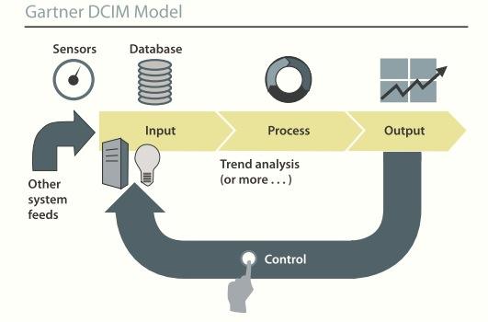
What is DCIM?
Definition and model
Gartner Research (circa 2011)
451 Research (circa 2014)
Datacenter Service Optimization (DCSO)
Data Center Business Planning
Data Center Service-Based Costing
Data Center Service Management
Data Center Energy Management
Data Center Infrastructure Management (DCIM)
Cooling Optimization
Data Center Asset Capacity Mgmt
Data Center Monitoring
Core DCIM Platform
enables more AGILITY
Gartner Research
Tools that optimize data centers by monitoring, managing IT and facility resources, and energy consumption…
451 Research
A system that collects and manages information about a data center’s assets, resource use and operational status…
Notes:
The solution is commonly referred to as data center infrastructure management or DCIM. It refers to good practices enabled by a tool—a software platform. It’s important to understand what this tool is and what it does… Let’s take a quick look at definitions and models from Gartner Research and 451 Research. In short: <read slide>
Both research firms go on to explain that this information is processed, integrated, analyzed and applied in ways that help managers meet business and service-oriented goals while continually optimizing their data center’s performance.
The definitions are nearly identical, but the models look very different. Gartner’s model, introduced around 2011, holds up very well. It includes a controls component and resembles what we see in the process automation industry. 451 recently introduced this model. It resembles a software stack. <click> Indeed, they are emphasizing SaaS capabilities on top of the DCIM platform.
What is different today are the services that work with a DCIM system—referred to as data center service optimization or DCSO—for planning and optimization, such as business planning, service-based costing, service management and energy management. These services enable a more agile data center.
--------------------
Sources:
¹ 451 Market Monitor Report, Data Center Technologies: DCIM, Dec 2011, page 2.
² Gartner Market and Analysis Statistics Report, Market Trends: Total Addressable DCIM Market Will Reach $1.7 B by 2016, 27-Nov-12, pages 2-3.
³ Forrester Market Overview: DCIM Solutions, Updated 3-Apr-2012, page 5.

Slide 13


Data center automation
Definition
Data center automation merges industrial monitoring and control systems, data center operations, and enterprise connectivity, to enable a fully automated data center. In addition to monitoring, analytics and workflow, it provides intelligent, flexible, adaptable and ultimately autonomous control of the entire data center or fleet of data centers.
Notes:
Another important concept to understand is data center automation, because through automation your data center customers can enjoy the highest levels of reliability and efficiency.
This is ABB’s definition of data center automation <read slide>.
With that understanding, let’s take another look why DCIM/DCSO and the evolution of data centers and when DCIM and DSCO have come into play <next slide>.

Slide 14
Evolution of data centers
High density, high power, high utilization, high flexibility
Example of a typical enterprise data center (with no advanced cooling):
White space: 15,000 sqft
Racks: 2,500
Power: Rack mount servers became popular around 1995 at about 2kW per rack.
White space: 150,000 sqft
Racks: 5,000
Power: 4 - 8 kW per rack
White space: 300,000 sqft
Racks: 10,000
Power: 5 - 17 kW per rack
DCIM
DCSO
1990
The last big data center boom during the dot-com bubble (1995 – 1999).
2000
2010
2020
DCIM market projected
at $1.7B in 2016
Notes:
Prior to DCIM and DSCO, data center managers faced ongoing challenges to optimize the efficiency of their data center resources—including energy—without adequate tools that would allow them to gain insight into power and environmental parameters, or to do capacity planning or predictive analysis. Economic pressures created a demand for tools to enable the monitoring, managing and control of data center assets and resources, such as IT and facilities infrastructure and the power needed run them.
Thus, you can see here where DCIM and DCSO solutions were recognized as a viable new market. Both Gartner and 451 project market growth to reach about $1.7B next year! This means that your data center customers—most likely among your largest consumers of energy in your territory—care very much about lowering their energy consumption—and avoiding penalties as a consequence of overages…
----------
Definitions from CIO.com:
Data center: Known as the server farm or the computer room, the data center is where the majority of an enterprise servers and storage are located, operated and managed. There are four primary components to a data center:
White space: This typically refers to the usable raised floor environment measured in square feet. For data centers that don’t use a raised floor environment, the term “white space” may still be used to show usable square footage.
Support infrastructure: This refers to the additional space and equipment required to support data center operations — including power transformers, your uninterruptible power source (UPS), generators, computer room air conditioners (CRACs), remote transmission units (RTUs), chillers, air distribution systems, etc. In a high-density, Tier 3 class data center (i.e. a concurrently maintainable facility), this support infrastructure can consume 4-6 times more space than the white space and must be accounted for in data center planning.
IT equipment: This includes the racks, cabling, servers, storage, management systems and network gear required to deliver computing services to the organization.
Operations: The operations staff assures that the systems (both IT and infrastructure) are properly operated, maintained, upgraded and repaired when necessary. In most companies, there is a division of responsibility between the Technical Operations group in IT and the staff responsible for the facilities support systems

Slide 15



How do you better manage IT and facility capacity to lower energy consumption and avoid penalties?
By managing the [3 Cs] in the data center:
Cost
Capacity
Control
DCIM provides the visibility, decision support and control of your data center assets that, if left unchecked, can squander resources in the form of wasted energy, stranded capacity, constrained agility and unscheduled down-time.
Notes:
By listening to our customers, we learned that all data center operators strive to do two things consistently: (1) deal with their capacity and (2) get a competitive advantage to process information and deliver data services faster than their competitors. To accomplish this, it’s important to continuously monitor and evaluate data center capacity, and to continuously invest in ‘tech refresh’ to stay in front of market demand… Our customers know what their budget is. One of their biggest concerns is spending it wisely to stay ahead of the market demand that their infrastructure must deliver. An excellent DCIM system, like Decathlon for Data Centers, provides the visibility, decision support and automation to enable them to manage their 3Cs: cost, capacity and control.
Without a DCIM system, resources can easily be squandered in the form of wasted energy and more…
<Read slide.>

Slide 16
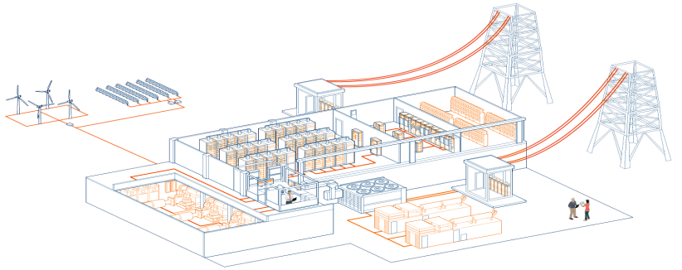
Why Use DCIM to Integrate Operations?
Energy Management
Resource Forecasting
& Energy Planning
Power Management
Asset & Capacity Planning
Remote Monitoring
Maintenance Management
Control and Automation
Data Center Evolution
Facility Management
Troubleshooting, Root Cause Analysis & Alarm Management
Notes:
In addition to enabling data center operators to improve their energy efficiency TODAY, equally important is a DCIM system is the platform from which to integrate NEW technologies that will help data centers evolve and achieve even greater operational benefits down the road. It’s one component of a comprehensive data center management strategy that improves reliability and efficiency today and ON THE HORIZON.
How many of you here have been in a data center? Perhaps your customer’s data centers?
A HUGE reason for the expanding role of DCIM is that it helps integrate operations… Let’s take a look at this illustration of a data center landscape to see why.
Here, we see the power chain—from distributed energy sources to servers in the racks. Plus we see the cooling infrastructure and even a NOC. Also, the top 10 capabilities necessary to manage a data center are labeled here. Each functional area of the data center requires specific expertise related to one or more of these capabilities. Each area of expertise has its own tools and technologies, for example:
<click> Your BMS may use BACnet.
<click> Your PMS may use Modbus, as well as hardwired I/O.
<click> Your EMS may use custom protocols, like ION.
<click> And, your IT systems may use SNMP, IPMI, ILOM, and so on.
The specialization required to run a mission critical facility can frequently contribute to chaos because of the lack of shared visibility and integration. Using a DCIM system helps take out the chaos from managing a data center because, fundamentally, it is the platform that enables you to have a truly holistic view of your data center operations. A good DCIM system is purpose-built to collect and normalize data from all types of communication protocols. A holistic view means the data set is complete: In theory, there are no gaps from which to arrive at faulty conclusions because of missing data…
Next, we’ll examine a customer case study and how they are using DCIM to significantly improve their energy efficiency and operations.

Slide 17
Customer case study
ABB Decathlon® for Data Centers

Slide 18

Customer goals and challenges
Energy management and business analysis
  Energy management
Cost containment
Capacity management
Business analysis
Forecasting: access to real-time trending data for space, power, cooling, connectivity and added services
Notes:
Challenge: This customer had been managing their IT operations with standard desktop productivity tools, such as Visio and Excel spreadsheets. These tools prevented their team from attaining real-time information because the data had to be imported into spreadsheets, or documents had to be manually updated and archived on a collaboration site. Plus, information sharing was more reactive than proactive. That is, if an IT operations manager wanted to see power and cooling information, then he would need to ask for it.
Consequently, their capacity management relied on wide margins of error, which also impacted the quality of their business analysis. That worked for a while—until they experienced market pressures that invited scrutiny of their operational effectiveness and web service delivery. They needed to modernize both their data center and their operations to keep up with changing business demands.
Consider: The operations team had to run around to collect data manually—from electric meters and RPP/branch circuits, to the outlet that supplies the power strips to the racks. Then, they dumped everything into spreadsheets so they could see trends and use this to analyze and forecast energy requirements. But none of this was integrated, so their data became unwieldy and prone to errors. To illustrate, the Energy Manager had to consolidate dozens of energy bills every month. Not just one power bill for each data center—some sites have multiple power bills depending on the site configuration! It was exceedingly time-consuming and tedious work. It took valuable time away from the actual analysis and forecasting—not to mention time away from resolving maintenance issues and making performance improvements.

Slide 19

Approach
Streamline ops using a single, self-maintainable tool
DCIM
Critical to success
System power and temperature data
IT asset tracking data
Third-party BMS, PMS and EMS system data
Include (or borrow) a data architect on your team—not just traditional MEP engineers
Colleagues on both facility and IT teams must embrace the too
Must address business, facility and IT objectives
Notes:
One component of their new data center strategy was to streamline their operations using one tool—a single operational environment—that provided real-time power and cooling information for IT asset management. It was very important to this customer to ensure both their CMDB data and ticketing system were integrated into their workflow using this tool. Plus, they desired a system they could maintain themselves—just like they had been doing with their spreadsheets.
Based on thus customer’s requirements, it was critical for their data to be transferred to the asset planning environment, and transformed if required. Integration included:
System power and temperature data
IT asset tracking data
Third-party BMS, PMS and EMS system data
They also brought on-board a data architect to work with their engineering team.
And, they understood it was imperative for colleagues on both the facility and IT teams to embrace the tool…
Last but not least, the operations team wanted to integrate and streamline a solution to address business objectives, not just facility and IT operations objectives. Their executive team required insight into operations to better allocate capital to their various data center sites. They needed a way of sharing performance data across the various roles—sales, marketing, operations and the ELT—so they could all work together toward realistic goals.

Slide 20
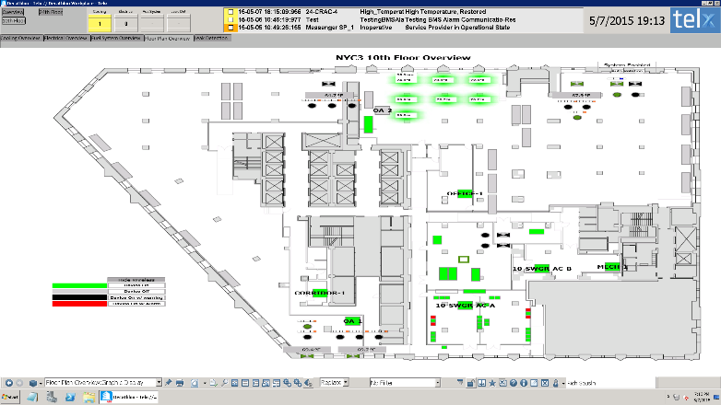
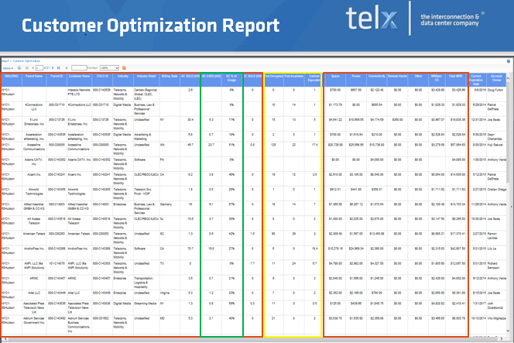
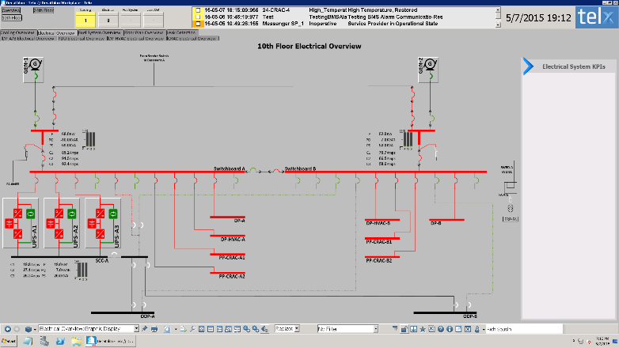
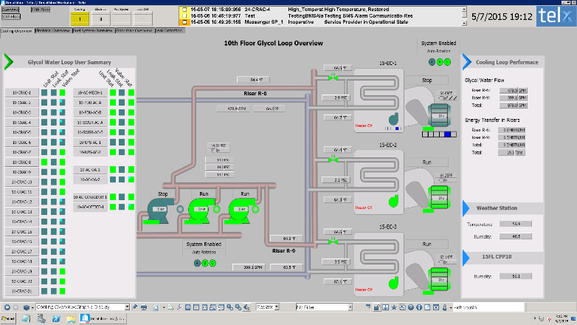
Results
Holistic visibility & automation for optimal performance
More complete and accurate information to focus on advancing service delivery rather than chasing the information to resolve maintenance issues. Sharing performance data enabled significant improvements to:
Single data source with multiple views for various roles
Business analyses and forecasting
Cost containment
Capacity management
Example of dashboards and a report from a single data source.
Notes:
They now have a real-time, interactive tool to proactively provide oversight of their data center operations. They are able to integrate their existing monitoring solutions (e.g., BMS, PMS, EMS) with other IT management tools, such as ticketing systems and service management tools through their DCIM system. As a result, they have more complete information that allows them to focus on advancing service delivery rather than chasing the information to resolve maintenance issues.
This customer now has a single data source with multiple view for various roles. On this slide, it’s not important to see the details of these dashboards; rather understand the improvements to business analyses and forecasting, cost containment and capacity planning enabled by holistic visibility and automation. For example, you can see <click> one of their facility floor plans with system performance data used by facilities, <click> their customer optimization report used by finance, <click> one of their power distribution dashboards used by electrical engineering, and <click> one of their glycol loops dashboards used by their mechanical engineers. Various roles looking at different view coming from the same data source.
Sharing performance data enabled significant improvements to their business analyses and forecasting, cost containment and capacity management.

Slide 21
Results
Data center business KPIs
Insight into processes and performance to compete and grow:
  Finance team uses it to analyze profit
  Sales team uses it to adjust pricing
  Product development and marketing teams use it to refine how services are sold to and consumed by customers
Sustainability dashboards and reports that reveal opportunities to reduce energy use in data centers, test labs, production sites and offices
A full value chain perspective
Notes:
Here are a few examples of how this customer is using their DCIM system to bring visibility to key performance indicators.

Slide 22
Utility analytics
Data center operations KPIs
Energy performance: BMS, PMS, EMS
System refresh with energy efficient models (e.g., server compute per kW)
Data center energy sourcing report (e.g., % of renewables)
Compliance baselining and reporting
Energy consumption – when, where and at what rate energy is being consumed
Carbon footprint report (e.g., PUE, CUE)
Sustainability dashboards and reports that reveal opportunities to reduce energy use in facility, including data centers, test labs, production sites and offices
Notes:
And here are some key performance indicators (KPIs) that directly apply to utility analytics.

Slide 23

Utility analytics
How big data is used with data centers
  Assess
Audit, review, monitor and/or follow the evolution of an issue. Disclose performance according to stakeholder demand.
Address
Manage efforts to tackle an issue. Investigate, steer and/or implement new governance procedures to ensure business sustainability and accountability.
Engage
Engage with stakeholders and lead discussions via positive advocacy to demonstrate the positive socio-economic and environmental effects of mobility, broadband and the cloud.
Source: http://www.ericsson.com/thecompany/sustainability-corporateresponsibility/materiality
Notes:
In another example, Ericsson is using their data center performance metrics as an integral part of managing their data centers. For more information, follow the URL on this slide to see their sustainability and corporate responsibility reports.

Slide 24

How soon will you be able to realize the benefits that a good DCIM system promises?
Decathlon® for Data Centers provides an industrial-grade DCIM system with controls to automate both workflow and physical infrastructure, enabling you to continuously optimize data centers to the highest levels of performance.
Notes:
These KPIs and performance efficiencies are made possible by a DCIM system, like Decathlon for Data Centers.

Slide 25

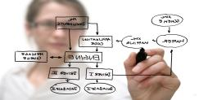


In summary…
Visibility
Decision Support
Automation
Notes:
That’s a lot to digest… Here’s a summary that’s easier to remember:
A DCIM system provides the visibility, decision support, and automation to effectively manage a flexible network of power, cooling and IT systems.

Slide 26
Call to action
ABB Decathlon® for Data Centers

Slide 27
Integrating data center performance metrics into your business strategy
  Call to action:
  Understand how your customers will assess, address and engage with their utility analytics. (Slide 23)
  (Help) identify what is important to measure, why, and if and how the data will be shared. (Slides 22)
  If your customer needs a DCIM system, please recommend ABB Decathlon for Data Centers in their evaluation. Let us know how we can help. (Slide 24)

Slide 28
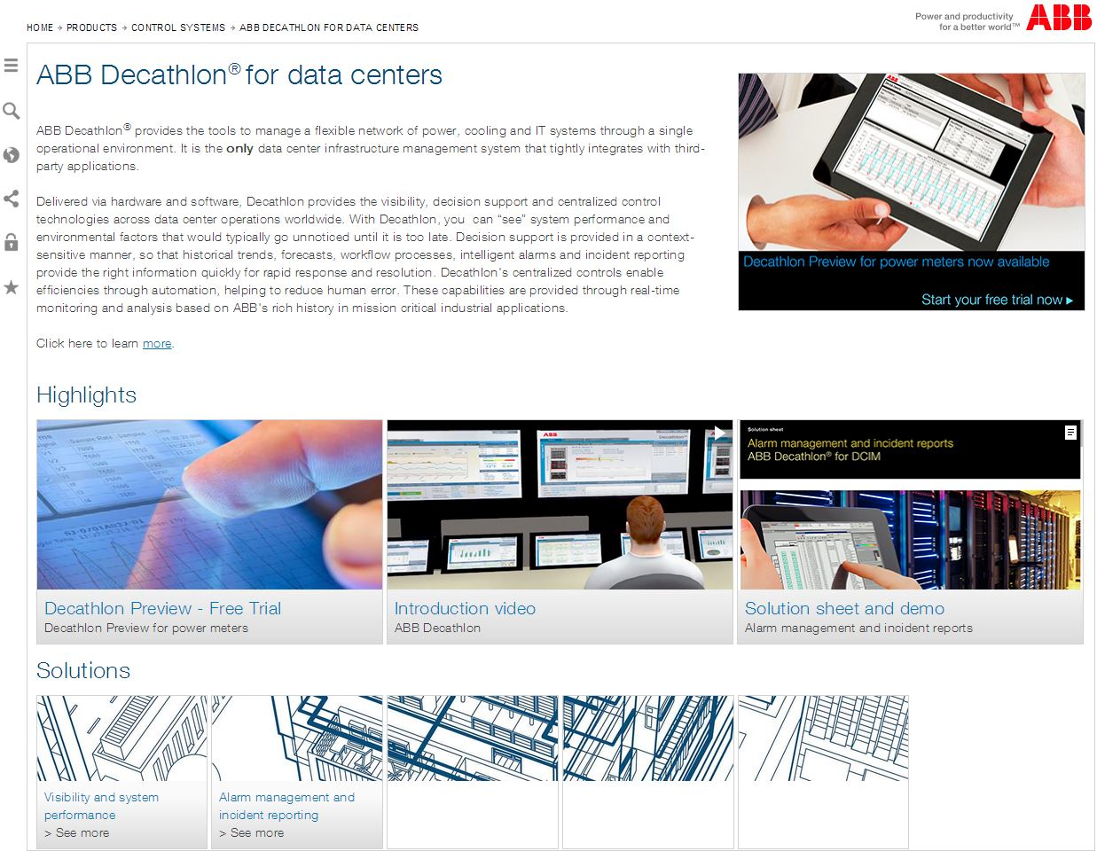
Learn more
www.abb.com/decathlon-datacenters
Decathlon Preview (trial software)
Brochure
Data sheet
FAQs
Supported protocols
Solution series
White papers
Additional questions?
Contact:
Marina Thiry
Director, Strategic Marketing – Data Centers
marina.thiry@us.abb.com
+1 (650) 799-8299
Include a screen shot of the Decathlon home page.

Slide 29
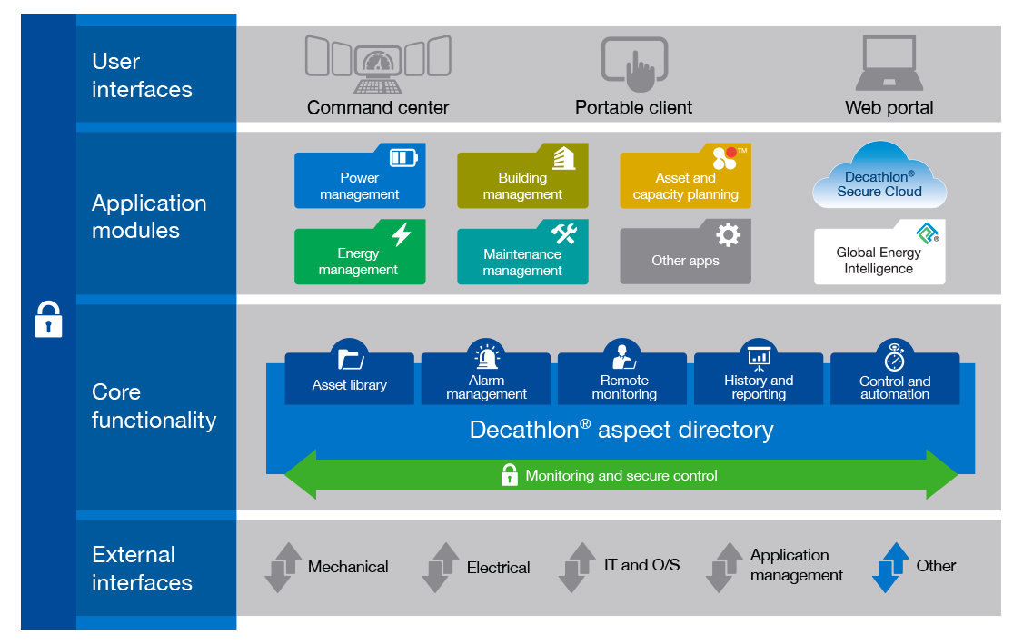
ABB Decathlon® for Data Centers system
Non-native apps (DCSO)

Slide 30


